Slide 1
M1 – 2 UNITEL Project survey analysis using advanced statistical and data mining methods: current state, state-of-the-art, and future perspective Dr. Hamid Reza Marateb University of Isfahan
UNITEL

Slide 2
Topics
Pedagogical concepts used in the design of the WP1 questionnaire
Pedagogy for technology-enhanced learning
The ACRS model
Reliability, and validity in survey analysis
Data mining and statistical analysis of surveys
Survey analysis results of Iranian Universities
Pedagogical concepts in Iranian universities and the state-of-the-art
The limitations of current pedagogical concepts and future activity
Notes:
The teacher starts the lesson describing the topics he/she will cover. All lessons always start with this formula: "In this lesson we will talk about: Topic 1 Topic 2 Topic n”.

Slide 3
Objectives
The objectives of the lesson are:
Understand the pedagogical concepts used to design the UNITEL Project survey (WP1)
Understand the methods used to assess the validity and reliability of questionnaires
Discuss the reliability of the WP1 questionnaire
Understand how to extract higher-level information from the WP1 questionnaire using statistical and data mining methods
Discuss he limitations and future activity of current pedagogical concepts of the courses presented in Iranian universities, compared to the state-of-the-art.

Slide 4
The WP1 questionnaire
Students’ Questionnaire:
Theory and practice
Self-regulation and motivation
Knowledge, skills, and attitudes
Working-life orientation
pedagogy for technology-enhanced learning and culture of teaching
Assessment
Faculty members’ Questionnaire:
Theory and practice
Self-regulation and motivation
Knowledge, skills, and attitudes
Companies and Business Actors
Notes:
The slides must be written with sobriety, without the use of too many colors (strictly necessary) and with short sentences. Line spacing 1-1.5.
Links to movies, pdfs, web pages and so on can be inserted. All hyperlinks must be openable from the ppt.
If there are hyperlinks in the slide, it is advisable to indicate, in the notes field, when the content of the link will be commented: before, after or simultaneously with the mouse click that opens the hyperlink. It is necessary for the Production (USGM) to acquire in advance all the videos downloaded from the Web (for example from YouTube).

Slide 5
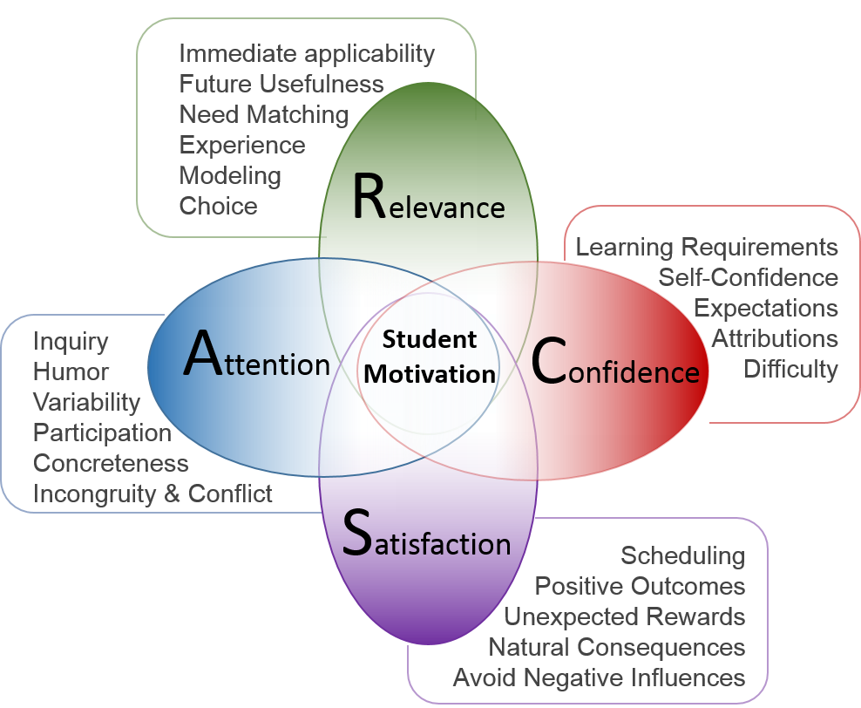
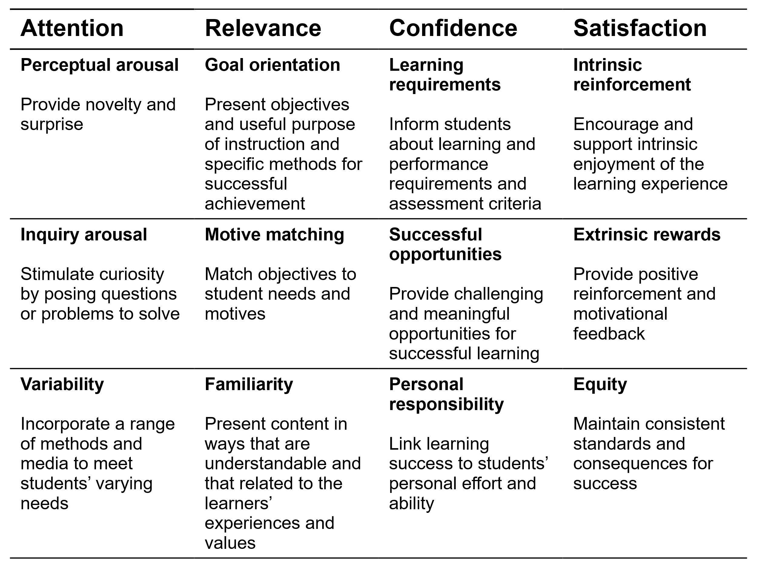
The ARCS model
Nicoguaro [CC BY 4.0 (https://creativecommons.org/licenses/by/4.0)],
from Wikimedia Commons;
https://pressbooks.bccampus.ca/arcanddl/chapter/chapter-1/
Serhat Kurt, “Model of Motivation: ARCS Instructional Design,”
https://educationlibrary.org/model-of-motivation-arcs-instructional-design/,
Access Date: 8/16/2022
L. Laurens-Arredondo, “Mobile augmented reality adapted to the ARCS model of motivation: a case study during
the COVID-19 pandemic,” Education and Information Technologies, 2022/02/26, 2022.
Notes:
The slides must be written with sobriety, without the use of too many colors (strictly necessary) and with short sentences. Line spacing 1-1.5.
Links to movies, pdfs, web pages and so on can be inserted. All hyperlinks must be openable from the ppt.
If there are hyperlinks in the slide, it is advisable to indicate, in the notes field, when the content of the link will be commented: before, after or simultaneously with the mouse click that opens the hyperlink. It is necessary for the Production (USGM) to acquire in advance all the videos downloaded from the Web (for example from YouTube).

Slide 6
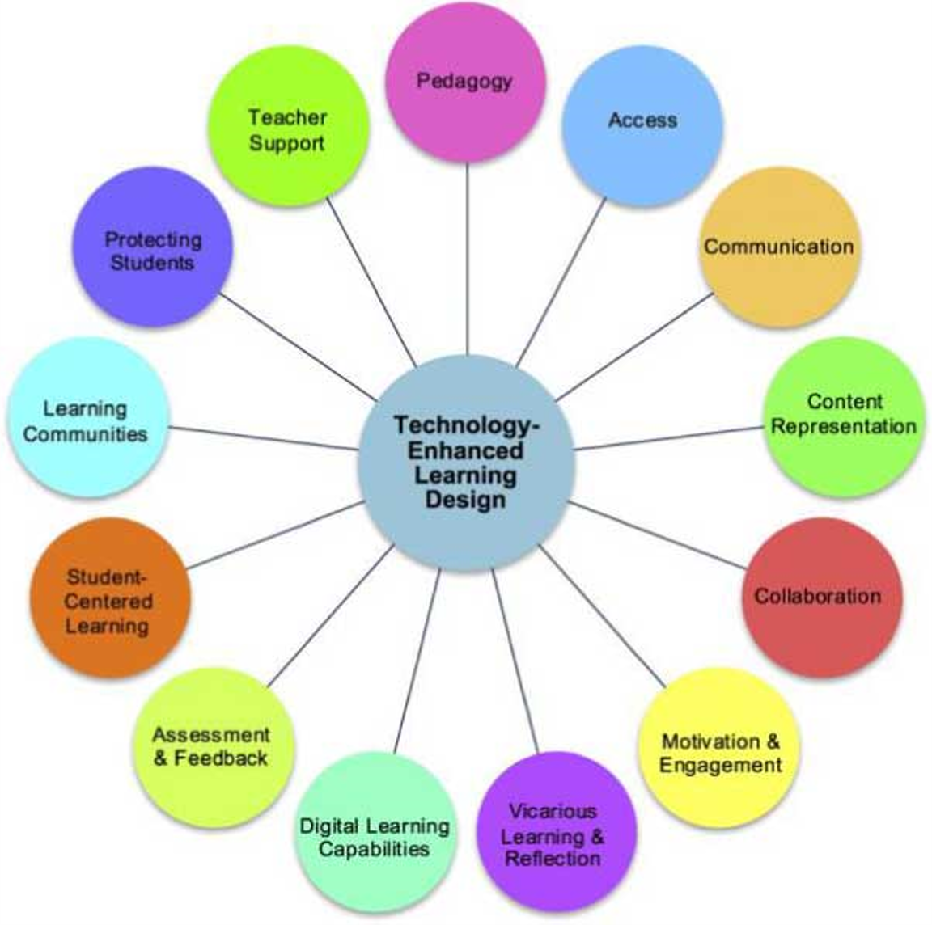
Technology-enhanced learning (TEL)
Using of technology and the Internet
The support of teaching and learning
Using of technology
Providing socio-technical innovations
for learning practices
M. Bower, "Technology-Enhanced Learning – Conclusions and Future Directions," Design of Technology-Enhanced Learning, pp. 405-428: Emerald Publishing Limited, 2017.
Notes:
The slides must be written with sobriety, without the use of too many colors (strictly necessary) and with short sentences. Line spacing 1-1.5.
Links to movies, pdfs, web pages and so on can be inserted. All hyperlinks must be openable from the ppt.
If there are hyperlinks in the slide, it is advisable to indicate, in the notes field, when the content of the link will be commented: before, after or simultaneously with the mouse click that opens the hyperlink. It is necessary for the Production (USGM) to acquire in advance all the videos downloaded from the Web (for example from YouTube).

Slide 7
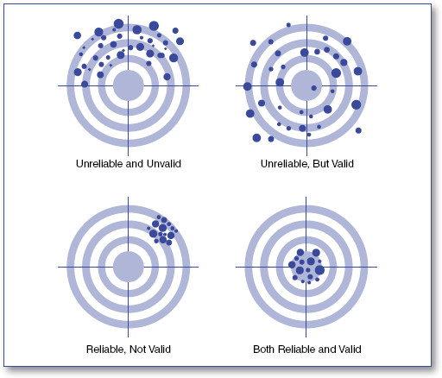
Survey analysis
Reliability
Test-retest reliability
Inter-rater reliability
Parallel-form reliability
Split-half reliability
Internal consistency
Validity
Face validity
Content validity
Criterion validity
Concurrent validity
Construct validity
E. Ruel, W. E. Wagner, III, and B. J. Gillespie, "The Practice of Survey Research: Theory and Applications," SAGE Publications, Inc, 2016.
M. Litwin, "How to Measure Survey Reliability and Validity," 1995.
Notes:
The slides must be written with sobriety, without the use of too many colors (strictly necessary) and with short sentences. Line spacing 1-1.5.
Links to movies, pdfs, web pages and so on can be inserted. All hyperlinks must be openable from the ppt.
If there are hyperlinks in the slide, it is advisable to indicate, in the notes field, when the content of the link will be commented: before, after or simultaneously with the mouse click that opens the hyperlink. It is necessary for the Production (USGM) to acquire in advance all the videos downloaded from the Web (for example from YouTube).

Slide 8
Statistical summary measure of the consistency of the WP1 Survey
Samples | Items | N | Cronbach's Alpha | CI 95% | ANOVA, Tukey’s test for non-additivity | Hotelling’s t^2 test
Faculty members | 35 | 87 | 0.765 | [0.688,0.831] | P<0.001 | P<0.001
University students | 42 | 96 | 0.890 | [0.857,0.920] | P<0.001 | P<0.001
Likert scale items were used.
Questions with high percentage of missing were deleted.
Deleting some Questionnaires did not improve the consistency.
.
Conclusion:
Items in the scale measure different sub-dimensions and that the items of the scale are summable.
The student’s survey is reliable but the faculty member’s survey is marginally reliable.
Notes:
The slides must be written with sobriety, without the use of too many colors (strictly necessary) and with short sentences. Line spacing 1-1.5.
Links to movies, pdfs, web pages and so on can be inserted. All hyperlinks must be openable from the ppt.
If there are hyperlinks in the slide, it is advisable to indicate, in the notes field, when the content of the link will be commented: before, after or simultaneously with the mouse click that opens the hyperlink. It is necessary for the Production (USGM) to acquire in advance all the videos downloaded from the Web (for example from YouTube).

Slide 9
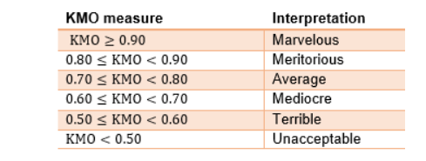
Clustering of confirmatory factor analysis (FA)
Students’ survey:
Number of Factors: 15
Rotation Method: Varimax
Clustering method: Two-step
Validation: AIC
Number of clusters: One
Faculty member’s survey:
Based on KMO,
No FA and also clustering
Were performed.
Notes:
The slides must be written with sobriety, without the use of too many colors (strictly necessary) and with short sentences. Line spacing 1-1.5.
Links to movies, pdfs, web pages and so on can be inserted. All hyperlinks must be openable from the ppt.
If there are hyperlinks in the slide, it is advisable to indicate, in the notes field, when the content of the link will be commented: before, after or simultaneously with the mouse click that opens the hyperlink. It is necessary for the Production (USGM) to acquire in advance all the videos downloaded from the Web (for example from YouTube).

Slide 10
Limitation of the learning methods during pandemic
Using One-sample Wilcoxon Signed Rank Test, we analyzed the limitation of the current “emergency online teaching”:
Students’ questionnaire item | Result | Significance
Hands-on experiences and practical actions important for training engineers are possible in an online learning environment. | Major Negative | P<0.001
Videos of experiments, research papers and study design exercises, and experimental data provided for analysis and interpretation could be a good alternative for practical action. | Major Negative | P<0.001
TEL changes the role of the student (before I was an information receiver, and now I build my own knowledge) | Major Negative | P=0.002
My motivation in online education is lower compared to face-to-face classes. | Major Positive | P<0.001
Notes:
The slides must be written with sobriety, without the use of too many colors (strictly necessary) and with short sentences. Line spacing 1-1.5.
Links to movies, pdfs, web pages and so on can be inserted. All hyperlinks must be openable from the ppt.
If there are hyperlinks in the slide, it is advisable to indicate, in the notes field, when the content of the link will be commented: before, after or simultaneously with the mouse click that opens the hyperlink. It is necessary for the Production (USGM) to acquire in advance all the videos downloaded from the Web (for example from YouTube).

Slide 11
Key obstacles in Emergency online learning
Finding coursework's challenging
The availability of the course instructors
Interaction with classmates
Missing course announcement
Understanding learning goals
Self-discipline in online environment
Academic misconduct
D. J. Lemay, P. Bazelais, and T. Doleck, “Transition to online learning during the COVID-19
pandemic,” Computers in Human Behavior Reports, vol. 4, pp. 100130, 2021/08/01/, 2021.
Notes:
The slides must be written with sobriety, without the use of too many colors (strictly necessary) and with short sentences. Line spacing 1-1.5.
Links to movies, pdfs, web pages and so on can be inserted. All hyperlinks must be openable from the ppt.
If there are hyperlinks in the slide, it is advisable to indicate, in the notes field, when the content of the link will be commented: before, after or simultaneously with the mouse click that opens the hyperlink. It is necessary for the Production (USGM) to acquire in advance all the videos downloaded from the Web (for example from YouTube).

Slide 12
Key obstacles Cont’d
R. Sodeify, Z. Habibpour, and M. Akbarbegloo, "Explaining medical students' perceptions of
asynchronous virtual education in the COVID-19 pandemic: A qualitative study,"
Journal of education and health promotion, 11, http://europepmc.org/abstract/MED/35677257
Notes:
The slides must be written with sobriety, without the use of too many colors (strictly necessary) and with short sentences. Line spacing 1-1.5.
Links to movies, pdfs, web pages and so on can be inserted. All hyperlinks must be openable from the ppt.
If there are hyperlinks in the slide, it is advisable to indicate, in the notes field, when the content of the link will be commented: before, after or simultaneously with the mouse click that opens the hyperlink. It is necessary for the Production (USGM) to acquire in advance all the videos downloaded from the Web (for example from YouTube).

Slide 13
Key obstacles Cont’d
Difficulties related to student-student interactions
Difficulties with self-regulated learning
Difficulties related to student-faculty interactions
Technical difficulties
Belief that learning became less effective during distance learning
Satisfaction with the way distance learning was organized at university
R. Y. Chan, K. Bista, and R. M. Allen, Online teaching and learning in higher
education during COVID-19: International perspectives and experiences: Routledge, 2021.
Notes:
The slides must be written with sobriety, without the use of too many colors (strictly necessary) and with short sentences. Line spacing 1-1.5.
Links to movies, pdfs, web pages and so on can be inserted. All hyperlinks must be openable from the ppt.
If there are hyperlinks in the slide, it is advisable to indicate, in the notes field, when the content of the link will be commented: before, after or simultaneously with the mouse click that opens the hyperlink. It is necessary for the Production (USGM) to acquire in advance all the videos downloaded from the Web (for example from YouTube).

Slide 14
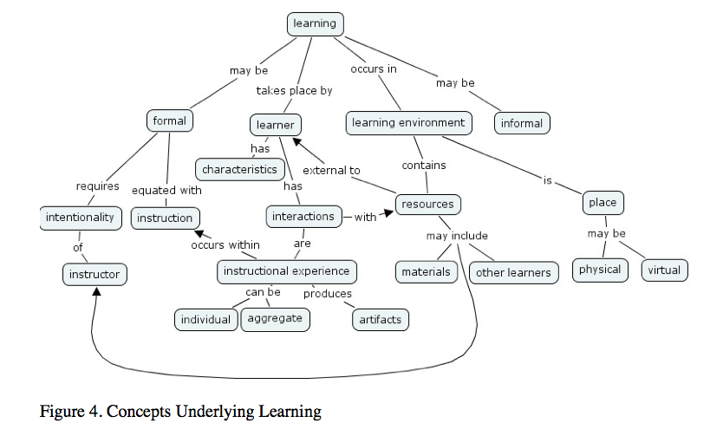
Action Plan
Proper E-learning
curriculum, virtual
, Remote lab design
Proper course validation
The application of
e-learning material in
Flipped classroom
Using Various methods,
including Project-Based
and Collaborative Learning
K. Thompson, Constructing educational criticism of online courses:
A model for implementation by practitioners: University of Central Florida, 2005.
Notes:
The slides must be written with sobriety, without the use of too many colors (strictly necessary) and with short sentences. Line spacing 1-1.5.
Links to movies, pdfs, web pages and so on can be inserted. All hyperlinks must be openable from the ppt.
If there are hyperlinks in the slide, it is advisable to indicate, in the notes field, when the content of the link will be commented: before, after or simultaneously with the mouse click that opens the hyperlink. It is necessary for the Production (USGM) to acquire in advance all the videos downloaded from the Web (for example from YouTube).

Slide 15
A case study by Marateb et al. 2022
Flipped classroom was provided in undergraduate and graduate courses (B.Sc., M.Sc., and Ph.D.. Of Biomedical Engineering) by a faulty member
Signal processing, Nonlinear Optimization, Bio-statistics, and Medical data mining courses
Various methods (PBL, CL, etc.) were implemented
The reliability of the questionnaire was assessed.
Main results: Proper e-learning material could be used in blended learning
Samples | Items | N | Cronbach's Alpha | CI 95% | ANOVA, Tukey’s test for non-additivity | Hotelling’s t^2 test
BME students | 21 | 59 | 0.760 | [0.661,0.840] | P<0.001 | P<0.001
Items in the scale measure different sub-dimensions and that the items of the scale are summable.
The student’s survey is marginally reliable.

Slide 16
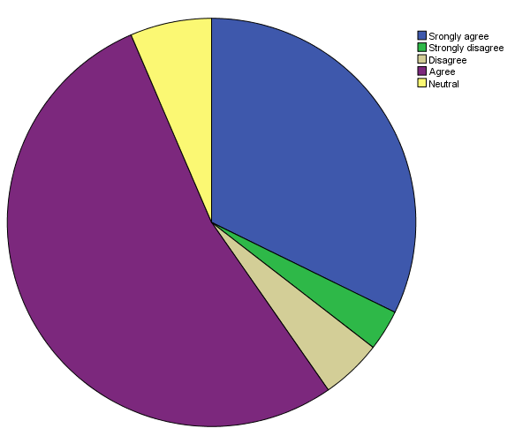
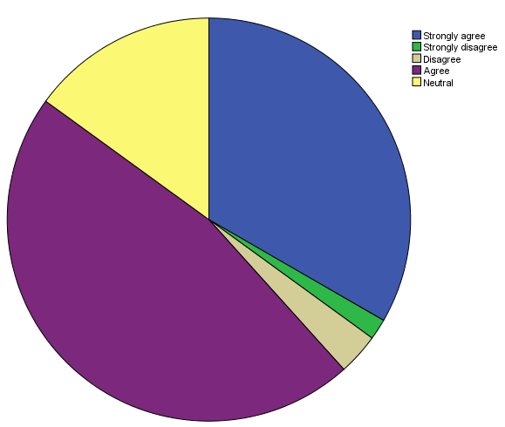
The case study, Cont’d
The Flipped classroom is more engaging
than traditional classroom instruction.
I am more motivated to learn Engineering or science
course in the Flipped Classroom.

Slide 17
The case study, Cont’d
Using One-sample Wilcoxon Signed Rank Test, we analyzed the application of the “Flipped Classroom”:
Students’ questionnaire item | Result | Significance
I would rather watch a traditional teacher lesson than a lesson video. | Major Negative | P<0.001
The Flipped classroom gives me more time to perform laboratory activities in class. | Major Positive | P<0.001
The Flipped classroom gives me more class time to practice problems. | Major Positive | P<0.001
The Flipped classroom gives me greater opportunities to communicate with other students. | Major Positive | P<0.001
Notes:
The slides must be written with sobriety, without the use of too many colors (strictly necessary) and with short sentences. Line spacing 1-1.5.
Links to movies, pdfs, web pages and so on can be inserted. All hyperlinks must be openable from the ppt.
If there are hyperlinks in the slide, it is advisable to indicate, in the notes field, when the content of the link will be commented: before, after or simultaneously with the mouse click that opens the hyperlink. It is necessary for the Production (USGM) to acquire in advance all the videos downloaded from the Web (for example from YouTube).

Slide 18
Conclusions
Proper survey analysis is important for policy-making
Some statistical methods are required for such a validation
Emergency online teaching leads to various learning problems
Proper e-learning is required for pandemics
Virtual and Remote labs must be provided for Science and Technology courses
Such materials are also useful in Flipped classroom
Notes:
The slides must be written with sobriety, without the use of too many colors (strictly necessary) and with short sentences. Line spacing 1-1.5.
Links to movies, pdfs, web pages and so on can be inserted. All hyperlinks must be openable from the ppt.
If there are hyperlinks in the slide, it is advisable to indicate, in the notes field, when the content of the link will be commented: before, after or simultaneously with the mouse click that opens the hyperlink. It is necessary for the Production (USGM) to acquire in advance all the videos downloaded from the Web (for example from YouTube).

