Slide 1
WP7
Project Management
Monica Fasciani
Università degli Sudi Guglielmo Marconi, Rome, Italy
UNI-TEL online kick-off meeting
1-2 February 2021

Slide 2
Modernisation and internationalisation of Iranian HEIs via collaborative TEL-based curriculum development in engineering and STEM/UNI-TEL
UNITEL main aims
The main idea underlying the project implementation is to improve technology enhanced learning methodologies within the involved HEIs in Iran and at the same time to boost current trends in pedagogy in order to enhance self-directed and collaborative learning.
Specific objectives:
Empowering engineering and STEM departments in IR universities in enhancing skills and competences of professors and instructional designers on innovative collaborative ICT-based practices as a means to increase curriculum modernisation and internationalisation
Modernisation of engineering and STEM curriculum through the development of flexible and accessible training path boosting new educational approaches based on technology enhanced learning and collaborative methodologies.

Slide 3
Modernisation and internationalisation of Iranian HEIs via collaborative TEL-based curriculum development in engineering and STEM/UNI-TEL
Partnership
P1 University Guglielmo Marconi (IT)
P2 University of Turku (FI)
P3 Universidade Aberta (PT)
P4 PRISMA (GR)
P5 Imam Khomeini International University
P6 University of Sistan and Baluchistan
P7 Shiraz University
P8 University of Isfahan
P9 University of Tehran
P10 Shahid Chamran University
P11 Sharif University of Technology
P12 Namvaran
‘In an unceasing search for innovating
higher education’

Slide 4
Modernisation and internationalisation of Iranian HEIs via collaborative TEL-based curriculum development in engineering and STEM/UNI-TEL
WP1
Baseline analysis
WP7
WP2
36 months
15/01/2021 – 14/01/2024
Project management
UNI-TEL training path development
0%
0%
0%
02
Project structure
02
WP6
UNITEL
WP3
Dissemination and exploitation
0%
0%
UNI-TEL training delivery
0%
0%
WP5
WP4
Quality assurance and evaluation
UNI-TEL curriculum modernisation

Slide 5
Modernisation and internationalisation of Iranian HEIs via collaborative TEL-based curriculum development in engineering and STEM/UNI-TEL
UNITEL beneficiaries
Direct beneficiaries:
First level:
Engineering and STEM departments professors and instructional designers (technical and pedagogical staff): they will be directly involved with a bottom up approach at all stages of the project implementation.
Second level:
HEI’s students: involved since the beginning in the baseline analysis and directly engaged in attending the modernised courses and providing their feedback on them
Indirect beneficiaries:
Educational public authorities, policy makers HEI managers, business associations.

Slide 6
1
COMMON GOALS
2
ACTION PLAN
3
DIFFERENCES
BUMPS
AHEAD

Slide 7
Proposal
10%
Project environment
90%
Different
Individuals (/personalities)
Countries (/cultures, currencies, languages, time zones)
Legal requirements
Institutional constraints
Notes:
Your proposal = tip of the iceberg
90% of the work to be done is influenced by your project environment. Any % which is not controlled in the project environment will have an impact on the project implementation.
International cooperation projects are complex → the consortium will have to reconciliate:
Different cultures
Different ways to operate
Different currencies
Different languages
Different timezones
Different legal frameworks
Different local contraints
Etc.

Slide 8
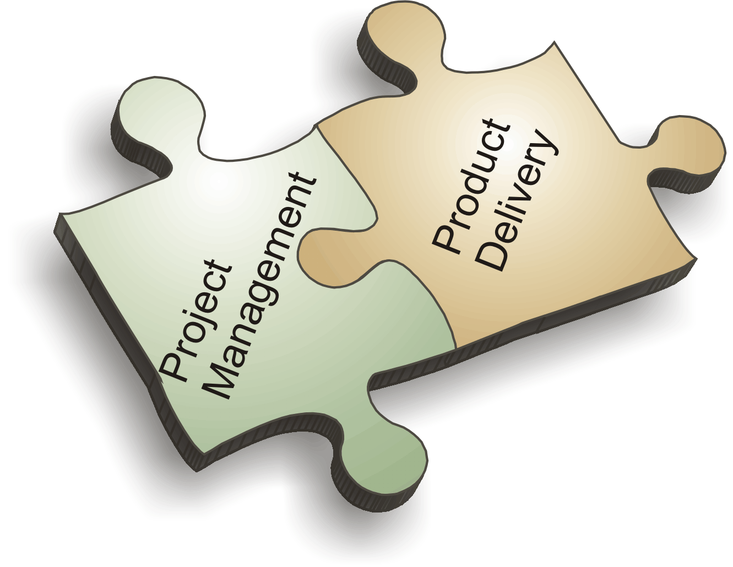
Modernisation and internationalisation of Iranian HEIs via collaborative TEL-based curriculum development in engineering and STEM/UNI-TEL
Aim and activities
AIM
Ensuring coordination of activities from a managerial and administrative point of view for the whole project duration, in order to meet the fixed objectives and achieve the project results.
ACTIVITIES
All partners will be in charge of the project management which includes:
Operative, financial & administrative management
Monitoring and reporting activities
Plenary and virtual meeting organization/attendance
‘In an unceasing search for innovating
higher education’

Slide 9
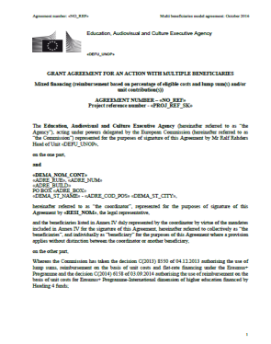
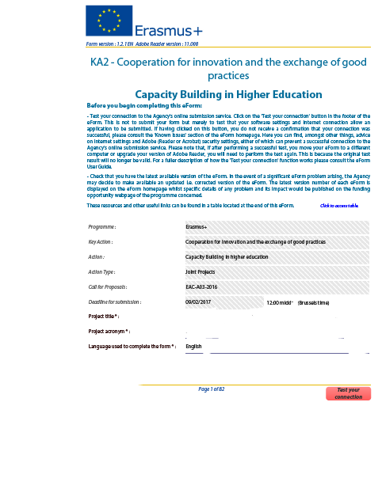
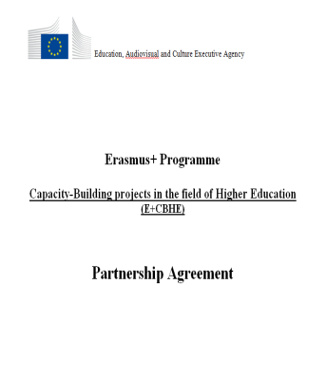
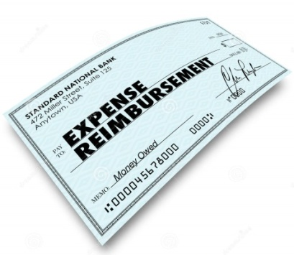
Modernisation and internationalisation of Iranian HEIs via collaborative TEL-based curriculum development in engineering and STEM/UNI-TEL
Rules and regulations
EC E+ CBHE regulations
National Legislation
Internal working arrangements
Institutional Practice
Notes:
Basically, you will have to work and comply with three different sets of rules, regulations, requirements, practices:
Those of the EC and E+ CBHE action
Those of the countries where your activities will be implemented
Those of the partner institutions and the institutions your project targets
In order to ensure you do so, you will have to design you own set or regulations and you own working arrangements under a Partnership Agreement that
constitutes a mandatory requirement for CBHE projects and that
similarly to the mandates constitutes a legally binding document among beneficiaries

Slide 10
Modernisation and internationalisation of Iranian HEIs via collaborative TEL-based curriculum development in engineering and STEM/UNI-TEL
Internal working arrangements
Obligations and responsibilities
OFFICIAL DOCUMENTS
Grant Agreement (n. 617496-EPP-1-2020-1-IT-EPPKA2-CBHE-JP) + Annexes
UNITEL Partnership Agreement between Coordinator and Partners
MONITORING TOOLS
UNI-TEL Project Handbook+ Annexes (Deliverable N. 7.1)
Work Plan (GANTT) to be periodically updated
LINKS
Google DRIVE
EACEA beneficiary space: https://https://eacea.ec.europa.eu/erasmus-plus/beneficiaries-space/capacity-building-in-field-higher-education-2020_en

Slide 11
Modernisation and internationalisation of Iranian HEIs via collaborative TEL-based curriculum development in engineering and STEM/UNI-TEL
Obligations and responsibilities
Grant Agreement – Legal Provisions
Role and obligations of the Beneficiaries
Multi-beneficiary Grant Agreement
Mandates: contractual link between EACEA and all beneficiaries
All beneficiaries are jointly responsible
In case of audits, checks or evaluation in their premises
Notes:
Let's start with the G.A
Importance of the notion of multi-beneficiary GA
All beneficiaries are jointly responsible for carrying out the project in accordance with the GA and have the same obligations. They are also jointly responsible in case part of the grant must be recovered, or if they are audited in their premises.
Only organisations can be beneficiaries (art 23 of the Erasmus+ Regulation)
From a contractual point of view, there are no more responsibilities for Partner Country beneficiaries than for Programme Country Beneficiaries, however from the operational point of view and for what concerns the quality and impact of the project, they have more responsibilities that their European partners.

Slide 12
Partnership agreement (Art. I.10.5)
Modernisation and internationalisation of Iranian HEIs via collaborative TEL-based curriculum development in engineering and STEM/UNI-TEL
Objectives:
Formalise internal project and grant management procedures
Institutional commitment to the project
Partnership conflict resolution
Guidelines available on Agency website
Negotiated with partners
Signed by Legal Rep. – 3 copies
Joint or Bilateral
Scanned copies to be submitted to EACEA at the latest 6 months after signature of G.A.
Notes:
Mandatory + must be signed at the latest 6 months after the signature of the grant agreement
Guidelines available on Agency website (should be adapted to the needs of the Partnership)
Joint parternship (one doc signed by all partners) is recommended because it is more transparent
Should be drafted in the working language of the consortium (and hopefully translated in the national language of the participating organisations)

Slide 13
Modernisation and internationalisation of Iranian HEIs via collaborative TEL-based curriculum development in engineering and STEM/UNI-TEL
Steering Committee
Internal decision-making and control committee led by USGM and composed of 1 manager from each partner organisation.
Main functions
Supervise project activities
Guarantee high level of quality of results achieved
Take the main decisions regarding the project activities
Resolve any possible contrasts
Provide strategic inputs to the project for liaisons with external entities and dissemination and exploitation strategy
SC member = contact person as per Art. 8 of PA

Slide 14
Modernisation and internationalisation of Iranian HEIs via collaborative TEL-based curriculum development in engineering and STEM/UNI-TEL
WP Leadeships
WP LEADER TASKS:
Coordinate the set up of WP team
Coordinate and monitor WP activities
Define WP strategies and working methods
Collect and elaborates input and feedback
Timely implementation of WP activities & production of WP deliverables
WP1 – P11 SUT
WP2 – P2 UTU
WP3 – P4 PRISMA
WP4 – P1 USGM
WP5 – P3 UaB
WP6 – P7 SU
WP7 – P1 USGM (P9 TU National coordinator)

Slide 15
Modernisation and internationalisation of Iranian HEIs via collaborative TEL-based curriculum development in engineering and STEM/UNI-TEL
Communication flow
The communication flow among all organizations involved in the project proceeds according to the followings pattern:
PROJECT COORDINATOR
AGENCY
PARTNERS
PROJECT COORDINATOR
PARTNERS
AGENCY
Only the project Coordinator directly communicates with the EACEA Agency for the project

Slide 16
Modernisation and internationalisation of Iranian HEIs via collaborative TEL-based curriculum development in engineering and STEM/UNI-TEL
Internal communication
Mainly takes place by using Zoom, Hangout and Skype
Documents will be shared via Google drive
Each WP Leader will set up WP “working groups”
Coordinator is informed on the progress of the activities and main decisions by WP Leaders
Communication about day-by-day project issues should be restricted among the members of the working group
Coordinator involved in important communications
Notes:
Explain that in order to be able to modify documents on drive they need to have an account otherwise they cannot edit documents! We could also foresee a private area on the project website but we always have problems of size of files to be uploaded and you cannot use it to share documents to be edited by more partners!
Research and educational team
Development team
Piloting team
QA team
Valorisation team

Slide 17
Modernisation and internationalisation of Iranian HEIs via collaborative TEL-based curriculum development in engineering and STEM/UNI-TEL
External communication
Project publications and results (Art. I.10.9):
Must include logo and disclaimer:
See Agency's website:
https://eacea.ec.europa.eu/about-eacea/visual-identity-and-logos-eacea/erasmus-visual-identity-and-logos_en
Notes:
Must display Erasmus+ Logo
Must include this sentence: "Co-funded by the Erasmus+ Programme of the European Union"
"This project has been funded with support from the European Commission. This publication [communication] reflects the views only of the author, and the Commission cannot be held responsible for any use which may be made of the information contained therein".
Legal requirements in the Grant agreement
Visibility of project results (Art. I.10.8, I.10.9, II.7.1)
Availability of materials produced
Use correct logo and disclaimers
Stickers on purchased equipment
Important to define stakeholders and plan dissemination according to target groups
Internal and external target groups (incl. public authorities)
Dissemination at regional / national / international levels
Check Annex II of the Erasmus+ Programme Guide: Practical Guide on Dissemination and Exploitation

Slide 18
Modernisation and internationalisation of Iranian HEIs via collaborative TEL-based curriculum development in engineering and STEM/UNI-TEL
Reporting: EACEA reporting
Two formal Periodic Reports must be submitted to the European Commission including:
Technical Implementation Report
Financial Statements
M21 → M22
at the concluding stage of the project (M36) → 2 months after UNITEL end
References:
Grant Agreement Art I.4.1 + Annex V
Tools: https://eacea.ec.europa.eu/erasmus-plus/beneficiaries-space/capacity-building-in-field-higher-education-2020_en
Section: REPORTING
When?

Slide 19
Modernisation and internationalisation of Iranian HEIs via collaborative TEL-based curriculum development in engineering and STEM/UNI-TEL
1st internal reporting
3rd internal reporting
September 2022
M21
January
2024
M36
November 2021
M10
April 2023
M28
Instructions & templates
for internal reporting:
Management Handbook
Final report to EACEA
Interim report for the EACEA and 2nd internal reporting
Notes:
TEMPLATES TO BE PROVIDED BY MID MARCH ON DRIVE. Each partner must fill in the document but the WP leader will have the task to provide an overview of their wP

Slide 20
UNITEL project will be monitored by EC…
Modernisation and internationalisation of Iranian HEIs via collaborative TEL-based curriculum development in engineering and STEM/UNI-TEL
a) On an on-going "ad hoc basis" whenever considered necessary
b) On a "periodic basis" in accordance with a specific timetable:
Field monitoring:
Will be conducted by PO since no NEO is foreseen for the area
Notes:
6 months after the beginning: When you will deliver your Partnership Agreement it will be the moment when your PO will check your website, ensure a quick off meeting has taken place as well as payment to partners, etc.
Mid term At progress report stage you will be provided with his/her detailed recommendations
6 months before the end: The PO will ensure that all activities have been implemented, the equipment has been purchased and used, the partners have been paid.
After the end_ In the context of your final report
Check that the project advances according to the work plan
Check that partners are fully involved in the project
Prevent problems due to weak project implementation (penalties!)
Special emphasis on the visibility / sustainability/impact of the project results in the partner country(/-ies)

Slide 21
UNITEL Project Handbook
Modernisation and internationalisation of Iranian HEIs via collaborative TEL-based curriculum development in engineering and STEM/UNI-TEL
UNITEL Project Handbook
Internal guidelines for project management
Delivery date: Mid March 2021 – USGM
Key project information
Table of results/deliverables: roles & deadlines
Communication rules among the partners
Reporting obligations & deadlines
Financial Management
Annexes: reporting tools, project templates (deliverable template + PPT template), VAT certificate

Slide 22
UNITEL project meetings
Modernisation and internationalisation of Iranian HEIs via collaborative TEL-based curriculum development in engineering and STEM/UNI-TEL
Meetings allow partners to discuss and review project management, progress and achievement of results and future tasks.
Kick-off in online, 01-02 February 2021, USGM
Project meeting in Turku, Finland (M7), hosted by P2
Project meeting in Isfahan, Iran (M13), hosted by P8
Project meeting in Qazvin, Iran (M18), hosted by P5
Project meeting in Ahvaz, Iran (M24), hosted by P10
Project meeting in Shiraz, Iran (M28), hosted by P7
Final meeting in Tehran, Iran (M35), hosted by P9
Different virtual meetings will be scheduled between plenary meetings in order to better oversee project deadlines ensuring effectiveness and efficiency of resources and time.

Slide 23
UNITEL project meetings protocol
Modernisation and internationalisation of Iranian HEIs via collaborative TEL-based curriculum development in engineering and STEM/UNI-TEL
All partners are expected to be represented by at least 1 person (PM).
Dates will be selected so that everyone can participate.
Coordinator chairs meetings and is responsible for the agenda to be shared with partners at least 3 weeks before the meeting.
Partners can propose any agenda items at latest 2 weeks before the meeting.
Minutes will be sent to all the partners within 2 weeks of the meeting date – each host will organise minutes taking.
The host will assist the travelling partners with travel information.
The host will organize logistics for the meeting
All partners pay their own travel and subsistence costs for the meetings.

Slide 24
Modernisation and internationalisation of Iranian HEIs via collaborative TEL-based curriculum development in engineering and STEM/UNI-TEL
Staff involved in WP7
MONICA FASCIANI
m.fasciani@unimarconi.it
ILARIA REGGIANI
i.reggiani@unimarconi.it
RENZO LINSALATA
r.linsalata@unimarconi.it

Slide 25
Modernisation and internationalisation of Iranian HEIs via collaborative TEL-based curriculum development in engineering and STEM/UNI-TEL
ACTION | Responsible Partner | Deadline
Minutes of the meeting | USGM
Project handbook and reporting tools | USGM
Date of 2nd meeting in Turku/online | UTU
Website | SU (and partners)

Slide 26
NO PARTNER IS AN ISLAND

Slide 27
Modernisation and internationalisation of Iranian HEIs via collaborative TEL-based curriculum development in engineering and STEM/UNI-TEL

