Slide 1
EU partners role
In WP1
State-of the art

Slide 2
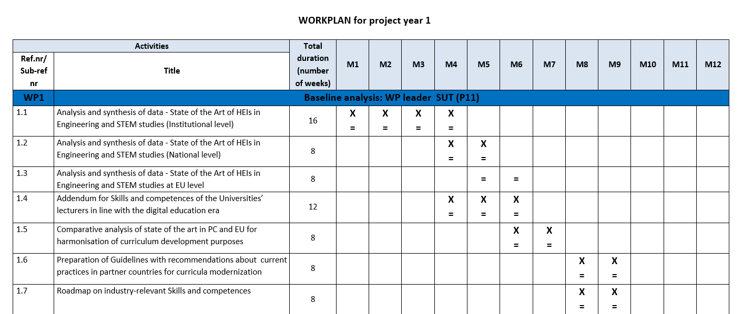
WP1 Dev. 1.3. & 1.5 EU universities role in collecting and analysing data for State of the Art

Slide 3
WP1 Dev. 1.3. Defining a State of the Art of HEIs at EU level
EU partner universities will collect data on the status of Engineering and STEM programmes in Europe. This activity will be coordinated by P2 UTU, the University of Turku, during months 5-6.
The data collection will feed information to other actions in the project:
Collecting the Comparative Analysis Report (WP1 Dev. 1.5)
Development of the e-Course, UNI-TEL training path development (WP2)
Aim is to describe how to improve, develop and implement the accreditation standards, guidelines and procedures for quality of TEL training and study programs at national level.

Slide 4
WP1 Dev. 1.5. Comparative analysis of state of the art of HEIs in Engineering and STEM studies in PC and EU.
Comparative analysis and synthesis will be made based on the state of the arts reports collected. This activity will be coordinated by Sharif University of Technology (P11) and University of Turku, (P2) and take place in months 6-7

Slide 5
^{Welcome to Turku!}
2nd partner meeting in Turku, Finland

Slide 6
WP1 outputs will be discussed in the 2nd partner meeting in Turku, Finland
This meeting will take place before the WP1 is finalized and it will be fundamental for gathering and agreeing on the contents, structure and methodology of dev.1.1 and define the inputs for dev.1.2 and 1.3.
During this meeting the consortium will lay the foundation for the implementation of WP2.

Slide 7
EIT Digital
The biggest European Universities of Technogy involved (a massive budget from the European Union)
Introducing Innovation & Entrepreneurship studies in their curricula on master & doctoral level (in IT programmes), I&E minor
The need for more IT start-ups & companies in Europe
Mostly online education (mixed educational methods)
Scalability of the courses => potential income for the universities in the future
Professionally edited videos; courses planned for individual & group activities

