Slide 1
WP7
Project Management
Monica Fasciani
Università degli Sudi Guglielmo Marconi, Rome, Italy
UNI-TEL second project meeting online
28-29 September 2021

Slide 2
Modernisation and internationalisation of Iranian HEIs via collaborative TEL-based curriculum development in engineering and STEM/UNI-TEL
WP1
Baseline analysis
WP7
WP2
36 months
15/01/2021 – 14/01/2024
Project management
UNI-TEL training path development
70%
15%
0%
02
Project structure
02
WP6
UNITEL
WP3
Dissemination and exploitation
0%
0%
UNI-TEL training delivery
10%
0%
WP5
WP4
Quality assurance and evaluation
UNI-TEL curriculum modernisation

Slide 3
Modernisation and internationalisation of Iranian HEIs via collaborative TEL-based curriculum development in engineering and STEM/UNI-TEL
WP1 Baseline analysis
Dev. 1.1 Comparative analysis (State of the Art of HEIs in Engineering and STEM studies)
Dev 1.2 Guidelines for modernising HEIs engineering and STEM studies curriculum integrating new pedagogical and digital learning approaches
Dev 1.3 Roadmap on industry-relevant Skills and competences
Leader: SUT and UTU
WP2 UNI-TEL training path development
Dev. 2.1 UNI-TEL training path
Dev. 2.2 UNI-TEL e-course
Dev 2.3 UNI-TEL virtual environment
Leader : UTU, PRISMA, SUT
Jan
2021
70%
Sep 2021
0%
Mar 2022
Sep
2021

Slide 4
Modernisation and internationalisation of Iranian HEIs via collaborative TEL-based curriculum development in engineering and STEM/UNI-TEL
WP3 UNI-TEL training delivery
Dev. 3.1 UNI-TEL training delivery report
Leader: PRISMA, USB
WP4 UNI-TEL curriculum modernisation -
Dev. 4.1 Modernised curricula
Dev 4.2 Modernised curricula - piloting report
Leader: USGM, TU
Nov
2021
0%
Jul 2022
0%
Nov 2023
Jul
2022

Slide 5
Modernisation and internationalisation of Iranian HEIs via collaborative TEL-based curriculum development in engineering and STEM/UNI-TEL
WP5 QUALITY ASSURANCE AND EVALUATION
Dev. 5.1 Evaluation plan
Dev. 5.2 Quality report for the project management
Dev. 5.3 Quality report for the products
Dev. 5.4 Final Evaluation Report
Leader: Uab, SCU
WP6 DISSEMINATION AND EXPLOITATION
Dev. 6.1 Valorisation plan
Dev. 6.2 UNI-TEL Website
Dev. 6.3 Paper products (brochure (B), poster (Po), papers)
Dev. 6.4 E-newsletter (3 per year)
Dev. 6.5 Final International Conference
Dev. 6.6 First national exploitation event
Dev. 6.7 Second national exploitation event
Dev. 6.8 Exploitation Agreement
Leader: SU, USGM
Nov
2021
0%
Jul 2022
0%
Nov 2023
Jul
2022

Slide 6
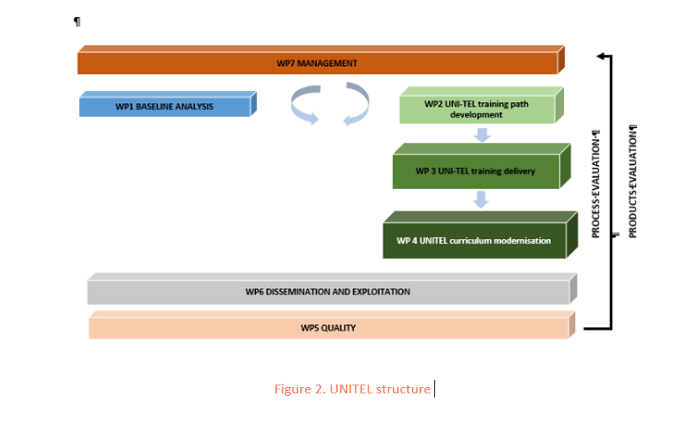
Modernisation and internationalisation of Iranian HEIs via collaborative TEL-based curriculum development in engineering and STEM/UNI-TEL
Project Management Structure
Nov
2021
0%
Jul 2022
0%
Nov 2023
Jul
2022

Slide 7
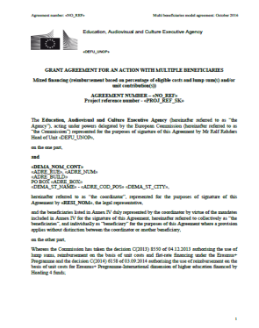
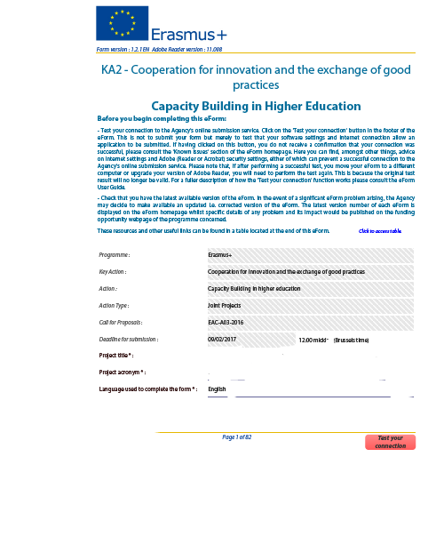
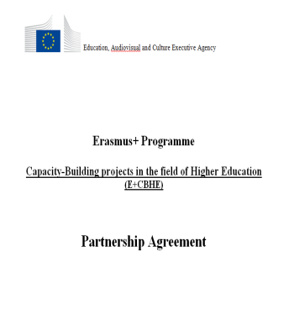
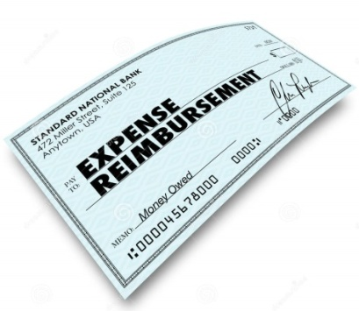
Modernisation and internationalisation of Iranian HEIs via collaborative TEL-based curriculum development in engineering and STEM/UNI-TEL
Rules and regulations
EC E+ CBHE regulations
National Legislation
Internal working arrangements
Institutional Practice
Notes:
Basically, you will have to work and comply with three different sets of rules, regulations, requirements, practices:
Those of the EC and E+ CBHE action
Those of the countries where your activities will be implemented
Those of the partner institutions and the institutions your project targets
In order to ensure you do so, you will have to design you own set or regulations and you own working arrangements under a Partnership Agreement that
constitutes a mandatory requirement for CBHE projects and that
similarly to the mandates constitutes a legally binding document among beneficiaries

Slide 8
Modernisation and internationalisation of Iranian HEIs via collaborative TEL-based curriculum development in engineering and STEM/UNI-TEL
Internal working arrangements
Obligations and responsibilities
OFFICIAL DOCUMENTS
Grant Agreement (n. 617496-EPP-1-2020-1-IT-EPPKA2-CBHE-JP) + Annexes
UNITEL Partnership Agreement between Coordinator and Partners
MONITORING TOOLS
UNI-TEL Project Handbook+ Annexes (Deliverable N. 7.1)
Work Plan (GANTT) to be periodically updated
LINKS
Google DRIVE
EACEA beneficiary space: https://https://eacea.ec.europa.eu/erasmus-plus/beneficiaries-space/capacity-building-in-field-higher-education-2020_en

Slide 9
Modernisation and internationalisation of Iranian HEIs via collaborative TEL-based curriculum development in engineering and STEM/UNI-TEL
Obligations and responsibilities
Grant Agreement – Legal Provisions
Role and obligations of the Beneficiaries
Multi-beneficiary Grant Agreement
Mandates: contractual link between EACEA and all beneficiaries
All beneficiaries are jointly responsible
In case of audits, checks or evaluation in their premises
Notes:
Let's start with the G.A
Importance of the notion of multi-beneficiary GA
All beneficiaries are jointly responsible for carrying out the project in accordance with the GA and have the same obligations. They are also jointly responsible in case part of the grant must be recovered, or if they are audited in their premises.
Only organisations can be beneficiaries (art 23 of the Erasmus+ Regulation)
From a contractual point of view, there are no more responsibilities for Partner Country beneficiaries than for Programme Country Beneficiaries, however from the operational point of view and for what concerns the quality and impact of the project, they have more responsibilities that their European partners.

Slide 10
Partnership agreement (Art. I.10.5)
Modernisation and internationalisation of Iranian HEIs via collaborative TEL-based curriculum development in engineering and STEM/UNI-TEL
Objectives:
Formalise internal project and grant management procedures
Institutional commitment to the project
Partnership conflict resolution
Guidelines available on Agency website
Negotiated with partners
Signed by Legal Rep. – 3 copies
Joint or Bilateral –HYBRID PA
Scanned copies to be submitted to EACEA at the latest 6 months after signature of G.A.
Notes:
Mandatory + must be signed at the latest 6 months after the signature of the grant agreement
Guidelines available on Agency website (should be adapted to the needs of the Partnership)
Joint parternship (one doc signed by all partners) is recommended because it is more transparent
Should be drafted in the working language of the consortium (and hopefully translated in the national language of the participating organisations)

Slide 11
Partnership agreement (Art. I.10.5)
Modernisation and internationalisation of Iranian HEIs via collaborative TEL-based curriculum development in engineering and STEM/UNI-TEL
1 PA with EU partners
Payments as described during the kick off
Institutional bank account
2 PA with IR partners
Payments revised and increased based on specific condition
Payment to Condor
Disbursement to each IR partner in person
Signed by Legal Rep. – 3 copies
Scanned copies to be submitted to EACEA at the latest 6 months after signature of G.A.
Notes:
Mandatory + must be signed at the latest 6 months after the signature of the grant agreement
Guidelines available on Agency website (should be adapted to the needs of the Partnership)
Joint parternship (one doc signed by all partners) is recommended because it is more transparent
Should be drafted in the working language of the consortium (and hopefully translated in the national language of the participating organisations)

Slide 12
Modernisation and internationalisation of Iranian HEIs via collaborative TEL-based curriculum development in engineering and STEM/UNI-TEL
Reporting: EACEA reporting
Two formal Periodic Reports must be submitted to the European Commission including:
Technical Implementation Report
Financial Statements
M21 → M22
at the concluding stage of the project (M36) → 2 months after UNITEL end
References:
Grant Agreement Art I.4.1 + Annex V
Tools: https://eacea.ec.europa.eu/erasmus-plus/beneficiaries-space/capacity-building-in-field-higher-education-2020_en
Section: REPORTING
When?

Slide 13
Modernisation and internationalisation of Iranian HEIs via collaborative TEL-based curriculum development in engineering and STEM/UNI-TEL
1st internal reporting
3rd internal reporting
September 2022
M21
January
2024
M36
November 2021
M10
April 2023
M28
Instructions & templates
for internal reporting:
Management Handbook
Final report to EACEA
Interim report for the EACEA and 2nd internal reporting
Notes:
TEMPLATES TO BE PROVIDED BY MID MARCH ON DRIVE. Each partner must fill in the document but the WP leader will have the task to provide an overview of their wP

Slide 14
UNITEL Project Handbook
Modernisation and internationalisation of Iranian HEIs via collaborative TEL-based curriculum development in engineering and STEM/UNI-TEL
UNITEL Project Handbook
Internal guidelines for project management
Delivery date: Mid March 2021 – USGM
Key project information
Table of results/deliverables: roles & deadlines
Communication rules among the partners
Reporting obligations & deadlines
Financial Management
Annexes: reporting tools, project templates (deliverable template + PPT template), VAT certificate

Slide 15
UNITEL project meetings
Modernisation and internationalisation of Iranian HEIs via collaborative TEL-based curriculum development in engineering and STEM/UNI-TEL
Meetings allow partners to discuss and review project management, progress and achievement of results and future tasks.
Kick-off in online, 01-02 February 2021, USGM online
Project meeting in Turku, Finland (M7), hosted by P2 online
Project meeting in Isfahan, Iran (M13), hosted by P8
Project meeting in Qazvin, Iran (M18), hosted by P5
Project meeting in Ahvaz, Iran (M24), hosted by P10
Project meeting in Shiraz, Iran (M28), hosted by P7
Final meeting in Tehran, Iran (M35), hosted by P9
Different virtual meetings will be scheduled between plenary meetings in order to better oversee project deadlines ensuring effectiveness and efficiency of resources and time.

Slide 16
UNITEL project meetings protocol
Modernisation and internationalisation of Iranian HEIs via collaborative TEL-based curriculum development in engineering and STEM/UNI-TEL
All partners are expected to be represented by at least 1 person (PM).
Dates will be selected so that everyone can participate.
Coordinator chairs meetings and is responsible for the agenda to be shared with partners at least 3 weeks before the meeting.
Partners can propose any agenda items at latest 2 weeks before the meeting.
Minutes will be sent to all the partners within 2 weeks of the meeting date – each host will organise minutes taking.
The host will assist the travelling partners with travel information.
The host will organize logistics for the meeting
All partners pay their own travel and subsistence costs for the meetings.

Slide 17
UNITEL study visits
Modernisation and internationalisation of Iranian HEIs via collaborative TEL-based curriculum development in engineering and STEM/UNI-TEL
Foreseen study visits:
M9 – October 2021 Turku
M13 – February 2022 Rome
To be moved February/March 2022

Slide 18
Modernisation and internationalisation of Iranian HEIs via collaborative TEL-based curriculum development in engineering and STEM/UNI-TEL
Steering Committee meeting
October/November 2021
Strategy on the management of time-cost
Revise action plan timing
Notes:
Internal decision-making and control committee led by USGM and composed of 1 manager from each partner organisation.
Main functions
Supervise project activities
Guarantee high level of quality of results achieved
Take the main decisions regarding the project activities
Resolve any possible contrasts
Provide strategic inputs to the project for liaisons with external entities and dissemination and exploitation strategy

Slide 19
Modernisation and internationalisation of Iranian HEIs via collaborative TEL-based curriculum development in engineering and STEM/UNI-TEL
GOOD IMPLEMENTATION OF PROJECT
Do important changes without consultation with coordinator
Respect deadlines
Take financial initiatives without authorization
Reply to e-mails
Communicate directly with project coordinator
Delay the purchase of equipment
Do not think this is just an institutional project – share info
Do not be afraid to ask
Notes:
Internal decision-making and control committee led by USGM and composed of 1 manager from each partner organisation.
Main functions
Supervise project activities
Guarantee high level of quality of results achieved
Take the main decisions regarding the project activities
Resolve any possible contrasts
Provide strategic inputs to the project for liaisons with external entities and dissemination and exploitation strategy

Slide 20
Modernisation and internationalisation of Iranian HEIs via collaborative TEL-based curriculum development in engineering and STEM/UNI-TEL
Staff involved in WP7
MONICA FASCIANI
m.fasciani@unimarconi.it
ILARIA REGGIANI
i.reggiani@unimarconi.it
RENZO LINSALATA
r.linsalata@unimarconi.it

Slide 21
NO PARTNER IS AN ISLAND

Slide 22
Modernisation and internationalisation of Iranian HEIs via collaborative TEL-based curriculum development in engineering and STEM/UNI-TEL

