Slide 1
WP4
UNI-TEL curriculum modernization
Prof. Matteo Martini
Università degli Sudi Guglielmo Marconi, Rome, Italy
UNI-TEL online kick-off meeting
1-2 February 2021

Slide 2
Modernisation and internationalisation of Iranian HEIs via collaborative TEL-based curriculum development in engineering and STEM/UNI-TEL
Project aims and results
The main general aim of the UNI-Tel project is to support modernization, internationalization and accessibility of the HE system within Iran through the development of innovative pedagogical approaches based on collaborative technology enhanced learning methodologies.
The development of modernised curriculum in engineering and STEM studies will be one of the main results of the project approach and has to be considered as a step towards an harmonisation process of the higher education systems in the EU and Iran.
‘In an unceasing search for innovating
higher education’
Matteo Martini Online Kick-off, 1-2 February 2021

Slide 3
Modernisation and internationalisation of Iranian HEIs via collaborative TEL-based curriculum development in engineering and STEM/UNI-TEL
WP4 as a landing point
In WP2 and WP3 we will prepare the e-course to faculty staff and deliver it to at least 91 professors and instructional designers
In WP4 we have the core of the experimentation; the modernization of the curriculum using the acquired skills and competences
Modernize means apply new methodologies exploiting:
new assessment methods through ICT-supported self-assessment activities based on a data mining system that allows a two way evaluation (from students and teachers’ perspective) of the training path
work with learning management systems (LMS) effectively through the use of innovative tools and systems (virtual labs, e-tivities etc.)
new approaches and ways for delivering university knowledge to economy and society and to strengthen the link between academia and the labor-market thus impacting on the knowledge triangle.
‘In an unceasing search for innovating
higher education’
Matteo Martini Online Kick-off, 1-2 February 2021

Slide 4
Modernisation and internationalisation of Iranian HEIs via collaborative TEL-based curriculum development in engineering and STEM/UNI-TEL
Piloting phase II
In UNI-TEL project, WP3 is indicated as First Piloting (with professors and IDs) while WP4 is the Second Piloting with students
The target is to modernize at least 10 courses in every PC HEIs involving at least 10 students per course
This implies a second piloting with at least 700 students
To avoid students reluctance it is fundamental to make them aware of the project from the beginning (building communication campaign, involving students in public discussions, creating exploitation events, etc.)
‘In an unceasing search for innovating
higher education’
Matteo Martini Online Kick-off, 1-2 February 2021

Slide 5
Modernisation and internationalisation of Iranian HEIs via collaborative TEL-based curriculum development in engineering and STEM/UNI-TEL
Course accreditation
The modernized courses must be approved by qualified academic board and delivered during UNI-TEL last year;
The approval process may be slightly different for HEIs but the blessing from an official board is mandatory;
Also for this passage, it is fundamental the involvement of university management into project activities and maintain a constant contact with them reporting progresses, results and difficulties
‘In an unceasing search for innovating
higher education’
Matteo Martini Online Kick-off, 1-2 February 2021

Slide 6
Modernisation and internationalisation of Iranian HEIs via collaborative TEL-based curriculum development in engineering and STEM/UNI-TEL
Expected results
Modernized University curricula in Engineering and STEM studies where the contemporary technology-based approaches and contents are integrated;
Ensuring quality of the teaching and learning process within Partner country universities through ICT-supported self-assessment activities based on a data mining system that allows a two way evaluation (from students and teachers’ perspective) of the training path;
Implementing a quality based approach for quality assurance of technology enhanced learning study programs according to standard accreditation practices at Iranian Universities.
‘In an unceasing search for innovating
higher education’
Matteo Martini Online Kick-off, 1-2 February 2021

Slide 7
Modernisation and internationalisation of Iranian HEIs via collaborative TEL-based curriculum development in engineering and STEM/UNI-TEL
Remote Labs
The trained professors and instructional designers will also set up 1 remote lab in each PC HEI.
With “remote lab” we intend a real laboratory experience equipped into university but fully controllable remotely
Not depending on the particular experience, equipment will be controlled and monitored using Arduino and Raspberry PI
A dedicated user interface will be prepared and integrated into LMS
Specific software will be purchased to enrich this educational experience
‘In an unceasing search for innovating
higher education’
Matteo Martini Online Kick-off, 1-2 February 2021

Slide 8
Modernisation and internationalisation of Iranian HEIs via collaborative TEL-based curriculum development in engineering and STEM/UNI-TEL
Remote Labs
Remote labs permit a real remote laboratory experience overcoming simulations limitations
The type of lab experience will be decided later depending on the didactical activities into each universities and on the selected courses
In GMU we are already using remote labs on electrical engineering with a dedicated platform connecting amplifiers, voltage generators, adjustable components, meters, etc.
‘In an unceasing search for innovating
higher education’
Matteo Martini Online Kick-off, 1-2 February 2021

Slide 9
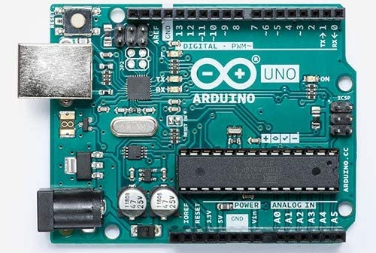
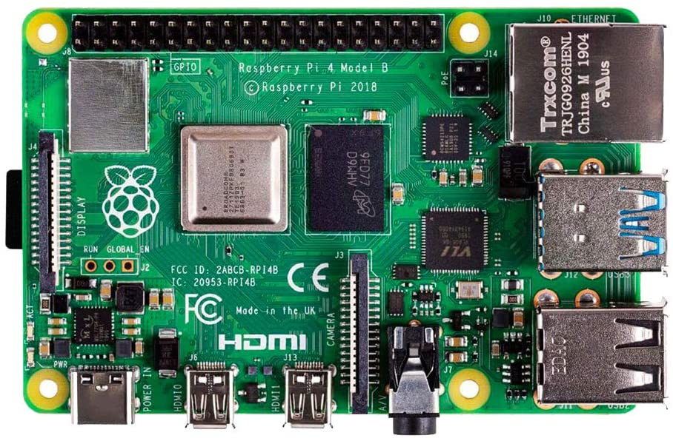
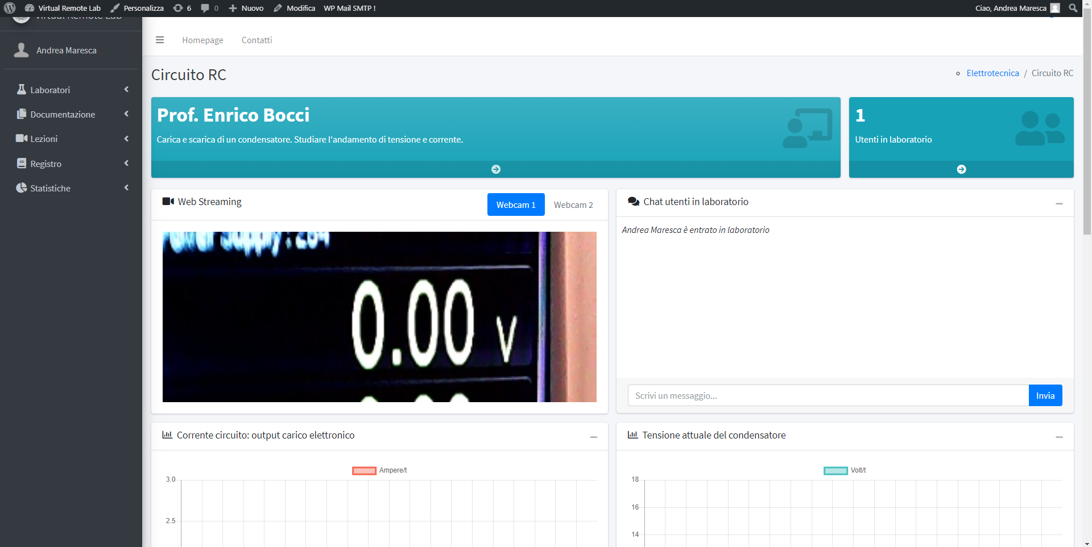
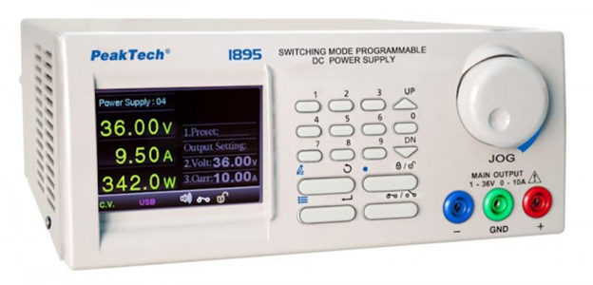
Modernisation and internationalisation of Iranian HEIs via collaborative TEL-based curriculum development in engineering and STEM/UNI-TEL
Remote Labs
Bi-directional communication
Remote setting
Live control
Automatic security check
Real lab experience
‘In an unceasing search for innovating
higher education’
Matteo Martini Online Kick-off, 1-2 February 2021

Slide 10
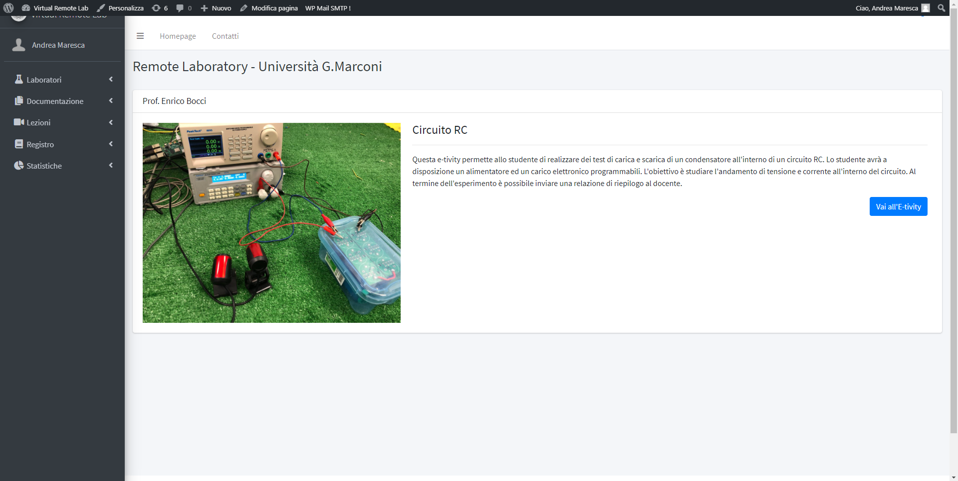
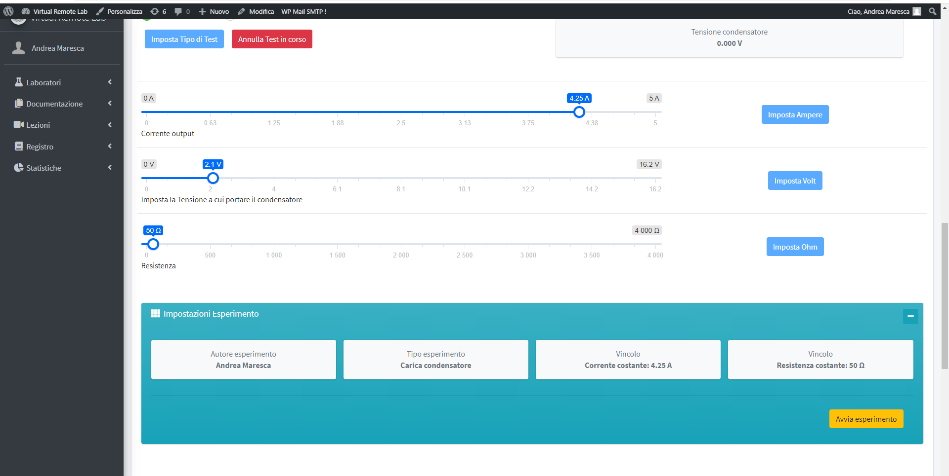
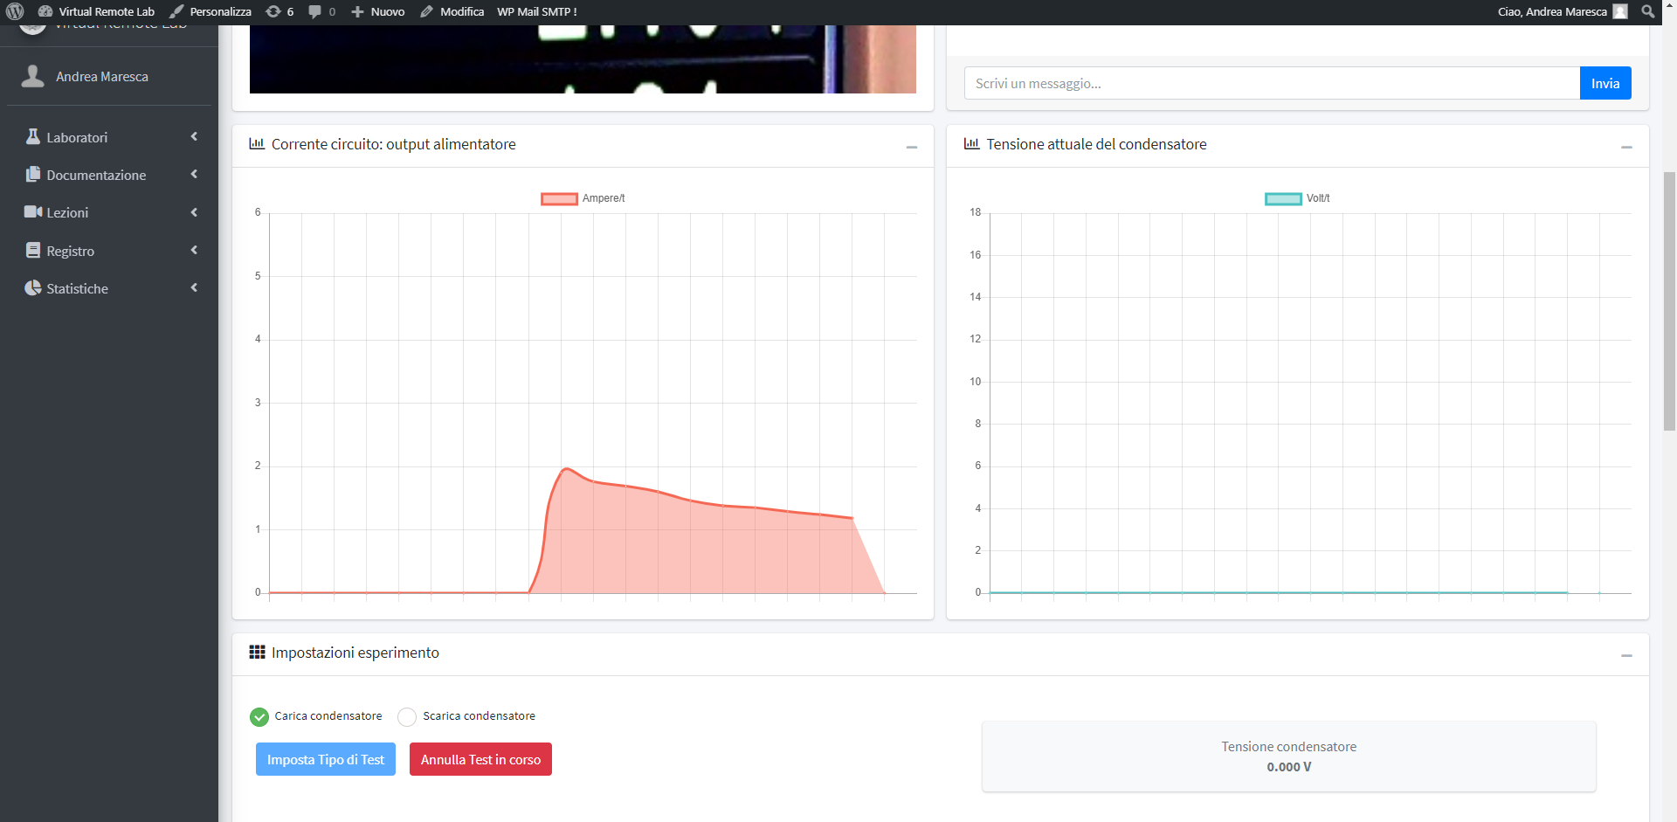
Modernisation and internationalisation of Iranian HEIs via collaborative TEL-based curriculum development in engineering and STEM/UNI-TEL
Remote Labs
‘In an unceasing search for innovating
higher education’
Matteo Martini Online Kick-off, 1-2 February 2021

Slide 11
Modernisation and internationalisation of Iranian HEIs via collaborative TEL-based curriculum development in engineering and STEM/UNI-TEL
Piloting additional results
The results of piloting will be compared, analyzed, processed and reported into the piloting report (Dev 4.2) at the end of the activity.
Lecturers and students will have the opportunity to interact into the Project e-platform social area with appropriate posts and will be part of different focus groups among peers and Piloting Team.
They also will be called to fill questionnaires and surveys for evaluation purposes.
The modernized courses need to be compliant with the Quality assurance standards for TEL as highlighted in one of the modules of the e-course that will especially focus on this topic.
‘In an unceasing search for innovating
higher education’
Matteo Martini Online Kick-off, 1-2 February 2021

Slide 12
Modernisation and internationalisation of Iranian HEIs via collaborative TEL-based curriculum development in engineering and STEM/UNI-TEL
WP4 timeline activities
2nd project year:
‘In an unceasing search for innovating
higher education’
3rd project year:
Matteo Martini Online Kick-off, 1-2 February 2021

Slide 13
Modernisation and internationalisation of Iranian HEIs via collaborative TEL-based curriculum development in engineering and STEM/UNI-TEL
Conclusion
WP4 can be considered the real in situ final piloting
WP1, WP2 and WP3 are fundamental to determine the most important concepts and to transmit them to instructors
The modernization of the courses during UNI-TEL must be not an arrival point but a starting point to implement new TEL methodologies into universities
Remember to always involve university management, academic board and students in UNI-TEL initiatives, their involvement will determine the success of the project
In this project we will learn and improve together!
‘In an unceasing search for innovating
higher education’
Matteo Martini Online Kick-off, 1-2 February 2021

