Slide 1
Activating methods and online tools to enrich online learning Mehri Rajaei University of Sistan and Baluchestan

Slide 2
Objectives
The objectives of the lesson are:
To get acquainted with the synchronous activating methods and online tools in the online classroom to challenge students for better understanding
To learn asynchronous tools to activate students for deeper learning
How to help student to maintain their concentration and deepens learning towards the higher-level skills like critical thinking
To get acquainted with activating methods to increase the accuracy and enthusiasm of students in following the educational content

Slide 3
Overview
Activating methods and tools in online classroom on BigBlueButton and Adobe Connect platform
poll
chat
whiteboard, split whiteboard
breakout
Asynchronous activating methods and tools on moodle platform
lesson
forum
padlet
assignment
...
Notes:
The teacher starts the lesson describing the topics he/she will cover. All lessons always start with this formula: "In this lesson we will talk about: Topic 1 Topic 2 Topic n”.

Slide 4
Activating methods and tools in online classroom on BigBlueButton and Adobe Connect platform

Slide 5
Poll
Polling students is similar to asking a question to a student body, except that the results are received very quickly and are often more accurate than a count of a raise of hands.
Polls can be used to
give students a way to express their opinions and thoughts.
check for understanding in real‑time.
help a teacher to collect feedback to improve your classes.
enhance classroom engagement
reachg students who are less apt to speak in class
There are three types of poll in BigBlueButton and Adobeconnect
Multiple Choice
Multiple Answers
Short Answer

Slide 6
Poll
BigBlueButton
Adobe Connect
Some other online poll tools : Survey Monkey, Flisti, Socrative,…

Slide 7
Chat
Chat in synchronous and online class can be used to:
Interact with student
Be aware of students question and problems
Check for understanding
Brainstorme question
Read answers and ask some of then to explain more about it
Teacher can download chat as document
In each session, one of the students can be held responsible for summarizing the points presented in the chat.

Slide 8
Whiteboard, Split Whiteboard
A online whiteboard is a learning space where both teachers and students can write and interact with students in real time via the internet.
Whiteboarding provides
Improved learning through increased participation and collaboration among students.
Alternate methods of learning (visual and auditory).
A tool to manage instruction so that students can construct their own knowledge and understanding from evidence.
A quick and cost-effective way of formatively assessing students.
Help in diagnosing students’ misconceptions.
A way to manage discussion by focusing students on the topic at hand

Slide 9
Whiteboard, Split Whiteboard
How to use whiteboard in BigBlueButton and Adobe Connect
BigBlueButton
Adobe Connect

Slide 10
Whiteboard, Split Whiteboard
Whiteboards while recording or sharing your screen
Canvas chrome app
Jamboard
Whiteboard app in Windows
Aww app
Whiteboard.fi
Whiteboard.chat
For see more tools refer to here

Slide 11
Breakout
Breakout rooms are used to create small group conversations or discussions as part of a larger online session.
Establish clear and concise goals for the session.
Group the students in different groups.
Assign a group leader or ask for a volunteer.
Specify the deadline time and start the break out
Move between rooms and monitor their activity and help them
End the breakout.

Slide 12
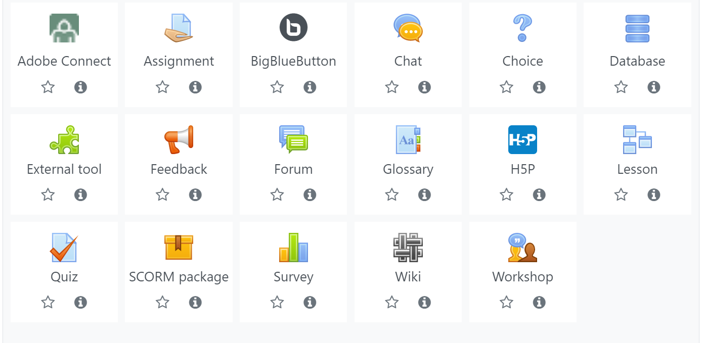
Asynchronous activating methods and tools on moodle platform

Slide 13
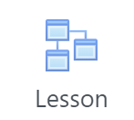
Lesson
The Lesson activity allows teachers to create 'branching' exercises where students are presented with content and then, depending on their responses, are directed to specific pages. The content may be text or multimedia.
In a course, with the editing turned on, choose 'Lesson' from the activity chooser.
If planned well, a lesson can present content and questions that can be customized to individual students with no further intervention from the teacher.
A Lesson can also be used effectively for managing formative assessments in the course.
First of all design your scenario plan
Teacher can see the report of student activity on lesson
Lesson can be graded or ungraded.
How to bulding lesson in moodle
Other simillar activity SCORM and h5p

Slide 14
Forum
The Forum activity allows students and teachers to exchange ideas by posting comments as part of a 'thread’.
Files such as images and media maybe included in forum posts
Forum types:
Standard forum for general use
Single, simple discussion
Question and Answer forum
Standard forum displayed in a blog-like format
For more information about setting refer to link1 and link2

Slide 15
Padlet
Padlet is a collaborative bulletin board tool that allows teachers and students to share ideas and resources.
Padlet has a wide range of functionality and can allow users to share comments, links, YouTube videos, files, images, etc.
Teacher can create a padlet and export it , then Embed in label or page activity in moodle
Create account on https://padlet.com
Padlet Tour

Slide 16
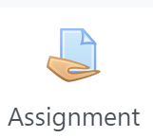
Assignment
Assignments allow students to submit work to their teacher for grading
The work may be text typed online or uploaded files of any type the teacher’s device can read.
Students may submit as individuals or in groups.
If comments are enabled site-wide, students will be able to add submission comments
Teacher can grade students' work anonymously
Teacher can read and grade student assignments offline
For more information about setting refer to link

Slide 17
Quiz
The Quiz is a very powerful activity that can meet many teaching needs, from simple, multiple-choice knowledge tests to complex, self-assessment tasks with detailed feedback.
Questions are created and stored separately in a Question bank and can be reused in different quizzes
Teacher can choose multiple type of Question (multiple choice, matching, essay, short answer, Drag and drop, tru/false,…) (for more detail)
can add random questions
Can randomize the order questions appear
Can make questions conditional upon other questions
Offers reports on: Grades report, response report,
statistics report, manual grading
For more information click here
…

Slide 18
Wiki
The WIki activity allows students to create a collaborative document by building pages together, similar to Wikipedia.
Wikis have many uses, such as:
For group lecture notes or study guides
For students to collaboratively author an online book, creating content on a topic set by their tutor
For collaborative storytelling or poetry creation, where each participant writes a line or verse
As a personal journal for examination notes or revision (using an individual wiki)…
For more information click here

Slide 19
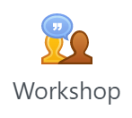
Workshop
Workshop is a powerful peer assessment activity
Workshop activity has five phases
Setup phase
Submission phase
Assessment phase
Grading evaluation phase
Closing the workshop
Workshop grading
Grade for submission
Grade for assessment
This grade (also known as grading grade) is calculated by the artificial intelligence hidden within the Workshop module as it tries to do a typical teacher's job.
For more inforamtion click here

Slide 20
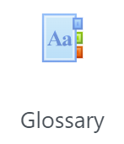
Glossary
The Glossary activity allows participants to create and maintain a list of definitions, like a dictionary.
The Glossary auto-linking filter will highlight any word in the course which is located in the Glossary.
The random glossary block can be used to display random entries from a glossary
Glossaries have many uses, such as
A collaborative bank of key terms
A ‘getting to know you’ space where new students add
their name and personal details
A ‘handy tips’ resource of best practice in a practical subject
A sharing area of useful videos, images or sound files
A revision resource of facts to remember
For more information click here

Slide 21
Game
The game activity module makes use of questions, quizzes and glossaries to create offer a variety of interactive games
The games are:
hangman
crossword
cryptex
millionaire
sudoku
Snakes and Ladders
The hidden picture
Book with questions

Slide 22
Feedback
The Feedback activity allows you to create and conduct surveys to collect feedback.
The Feedback activity is ideal for course or teacher evaluations.
helping improve the content for later participants.
Feedback responses may be anonymous if desired.
Results may be shown to all participants or restricted to teachers only.

Slide 23
Conclusions
Activity is something that a student will do that interacts with other students and or the teacher.
Some activities used in online class to engage student to follow the leeson
In some asynchronous activities students can grade and leave comment to each other (forum, workshop, glossary, …)
In some asynchronous activities only teacher grade and leave comment to student response and submission such as assignment and quiz

