Slide 1
Hydraulic and Sediment Transport Simulation using a 1D Numerical Model
Presented by: Dr. Asghar Azizian
Water Engineering Department, IKIU University
April, 2022

Slide 2
Topics
Introduction to 1D river modelling
Building a 1D model in Natural and man-made channel
Flood Inundation Mapping using remotely sensed DEMs and 1D Hydraulic Models
Hydraulic Modelling of Inline Structures (such as Bridge, Dam, Weir, Gate, and Culvert)
Scour Depth Estimation around Bridges using 1D HEC-RAS Model
Sediment Transport Modelling using HEC-RAS Model
Unsteady Flow Simulation in Natural Rivers and Flood Routing
Dam Breach simulation in Real Case Studies
Notes:
The teacher starts the lesson describing the topics he/she will cover. All lessons always start with this formula: "In this lesson we will talk about: Topic 1 Topic 2 Topic n”.

Slide 3
Objectives
The objectives of the lesson are:
By the end of this course, you will understand the 1D river modelling capabilities of HEC-RAS model and when to apply the software to different types of applications.
This course will allow you to familiarise yourself with the various tools and features within the software, allowing you to build your own 1D river model, run simulations, troubleshoot common modeling issues and interpret results.
You will learn all about Sediment Transport Modelling from zero to hero.
After this course, you will be a Master in River Modelling, Flood Inundation Mapping, Bridge Scour estimation, Dam Breach and Unsteady Flow Simulation for each case studies.

Slide 4
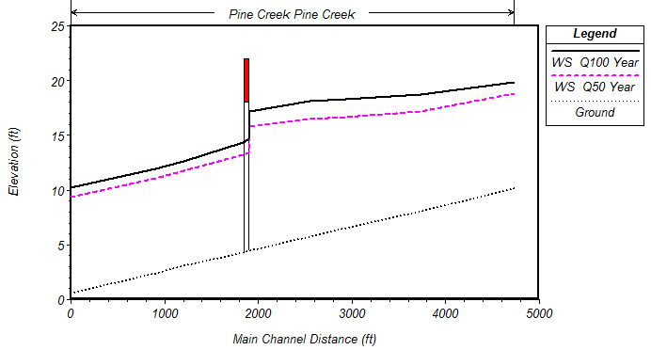
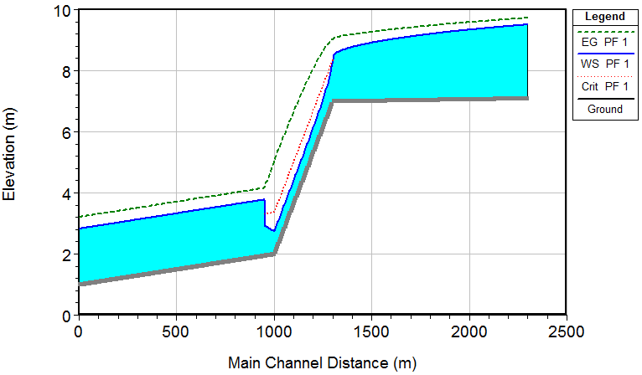
Topic 1: Introduction to 1D River Modelling
How to accesess and download HEC-RAS model and related datasets
Creating a Man-made Compound Channel Step-by-Step in HEC-RAS
You will learn how to estimate Manning Roughness Coefficient using Cowan Method
You will learn how to Define Boundary Conditions and Input Flow datasets.
Run the Model at differnt Plan and Compare the results
Download HEC-RAS 6.2 Model
Notes:
The slides must be written with sobriety, without the use of too many colors (strictly necessary) and with short sentences. Line spacing 1-1.5.
Links to movies, pdfs, web pages and so on can be inserted. All hyperlinks must be openable from the ppt.
If there are hyperlinks in the slide, it is advisable to indicate, in the notes field, when the content of the link will be commented: before, after or simultaneously with the mouse click that opens the hyperlink. It is necessary for the Production (USGM) to acquire in advance all the videos downloaded from the Web (for example from YouTube).

Slide 5
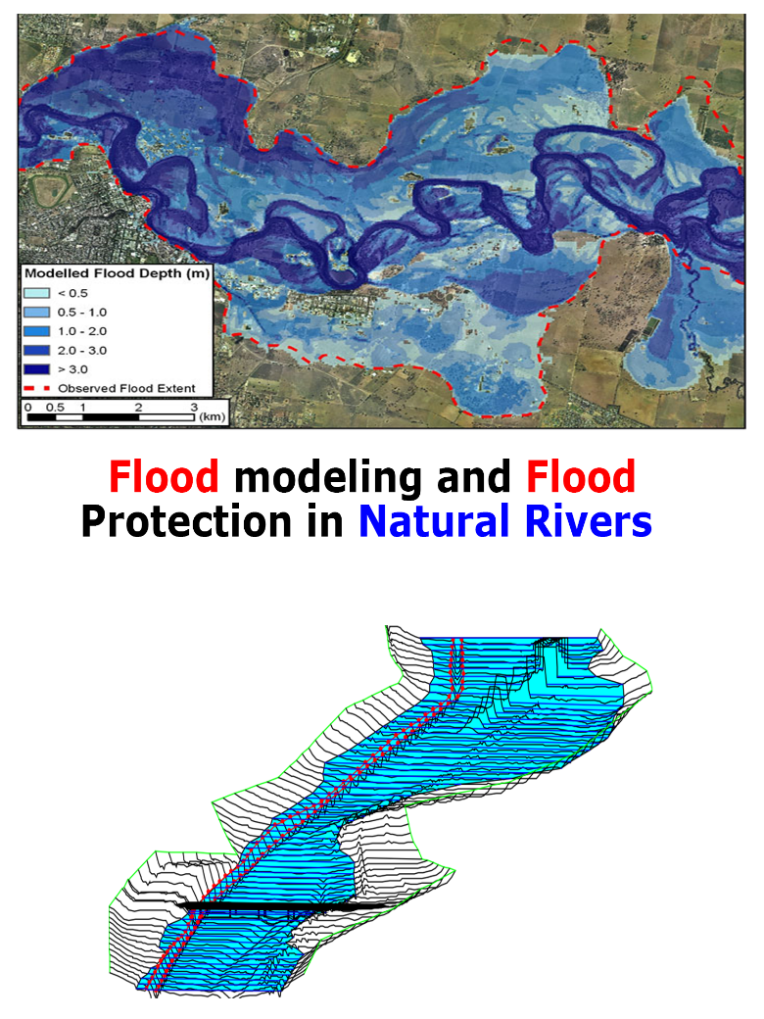
Topic 2: Flood Inundation Mapping using remotely sensed DEMs
Downloading different DEM sources such as SRTM-30m, ASTER-30m, ALOS-30m, SRTM-90m, Copernicus DEM-30m for a case study
Converting the Projection system from DD to UTM in ArcGIS.
Extracting 1D River Geometry in RAS Mapper Tools in HEC-RAS model based on Remotely Sensed DEM.
Importing Extracted Cross-Sections into Model, Defining Boundary Conditions, and Flow Input datasets
Run the Model for different Return Periods
Visualizing Flood Extents, Flood Depth, Velocity, and other Hydraulic Variables for the studied river.
Notes:
The slides must be written with sobriety, without the use of too many colors (strictly necessary) and with short sentences. Line spacing 1-1.5.
Links to movies, pdfs, web pages and so on can be inserted. All hyperlinks must be openable from the ppt.
If there are hyperlinks in the slide, it is advisable to indicate, in the notes field, when the content of the link will be commented: before, after or simultaneously with the mouse click that opens the hyperlink. It is necessary for the Production (USGM) to acquire in advance all the videos downloaded from the Web (for example from YouTube).

Slide 6
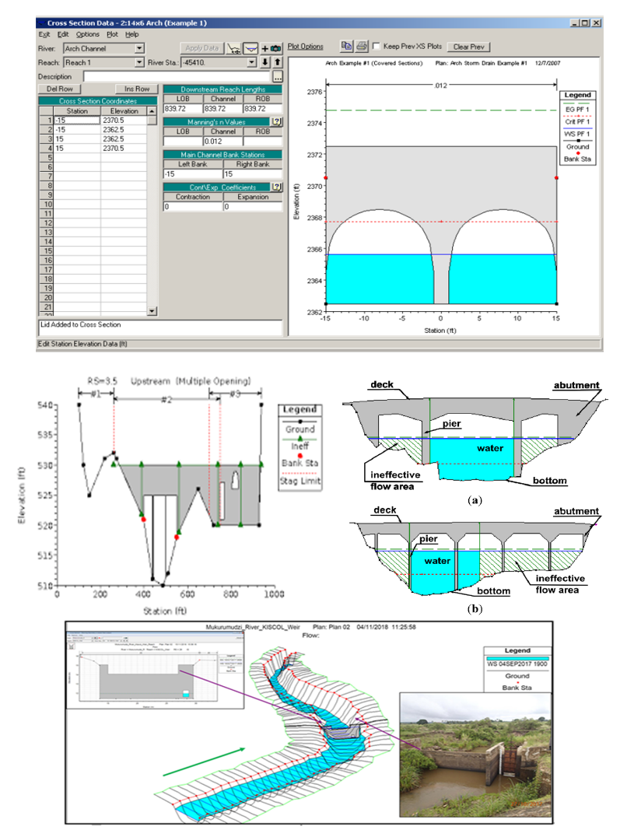
Topic 3: Hydraulic Modelling of Inline Structures (Bridge, Dam, Culvert, Gate)
You will learn how to define Piers, Road/Deck way and Abutments of a Bridge in a 1D model.
You will learn how to a DAM, Weir and Gate structures in a 1D model
Running Flow simulation and studying the Hydraulic Effects of Inline Structures (Such as back water, Flow profile over Dams and Weirs)
Visualising the Water Surface Profile around the struncures
Notes:
The slides must be written with sobriety, without the use of too many colors (strictly necessary) and with short sentences. Line spacing 1-1.5.
Links to movies, pdfs, web pages and so on can be inserted. All hyperlinks must be openable from the ppt.
If there are hyperlinks in the slide, it is advisable to indicate, in the notes field, when the content of the link will be commented: before, after or simultaneously with the mouse click that opens the hyperlink. It is necessary for the Production (USGM) to acquire in advance all the videos downloaded from the Web (for example from YouTube).

Slide 7
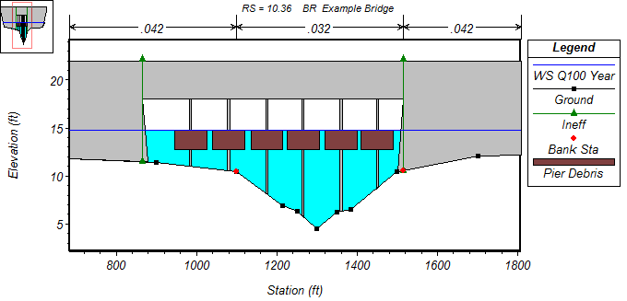
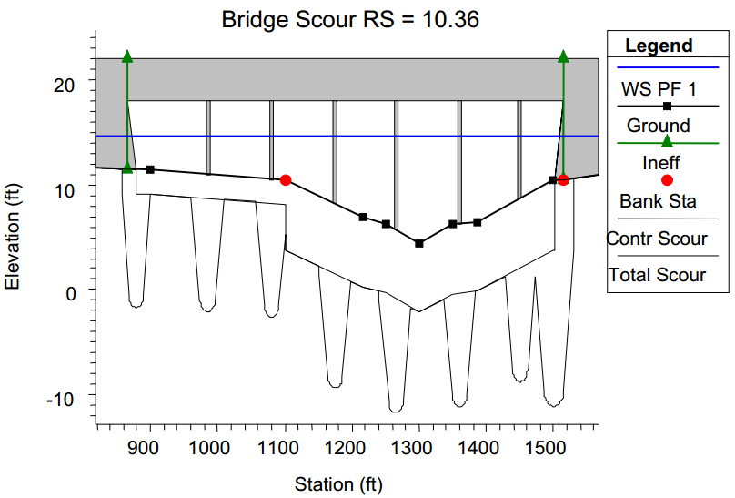
Topic 4: Scour Depth Estimation around Bridges using 1D HEC-RAS Model
Introduction to Bridge Scouring Concepts and Formulas
Assessing the benefits and limitations of each Bridge Scouring Formulas in HEC-RAS
Defining the required settings and parameters for different parts of a Bridge Scouring process (Contraction, Piers, and Abutments)
Running the 1D HEC-RAS model and Estimate the Scour depth profile around the piers and abutments
Modeling debris flow effects on hydraulic variables (Water Surface Profile, Depth, and Velocity)
Notes:
The slides must be written with sobriety, without the use of too many colors (strictly necessary) and with short sentences. Line spacing 1-1.5.
Links to movies, pdfs, web pages and so on can be inserted. All hyperlinks must be openable from the ppt.
If there are hyperlinks in the slide, it is advisable to indicate, in the notes field, when the content of the link will be commented: before, after or simultaneously with the mouse click that opens the hyperlink. It is necessary for the Production (USGM) to acquire in advance all the videos downloaded from the Web (for example from YouTube).

Slide 8
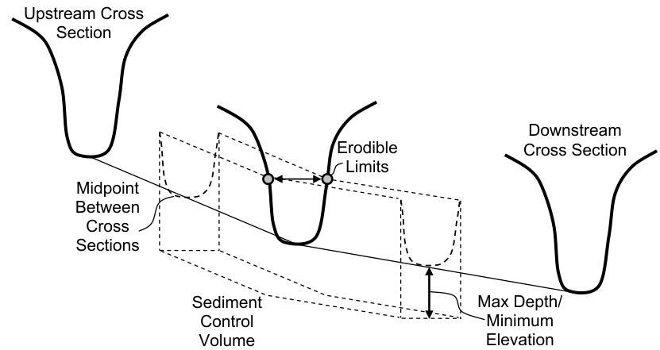
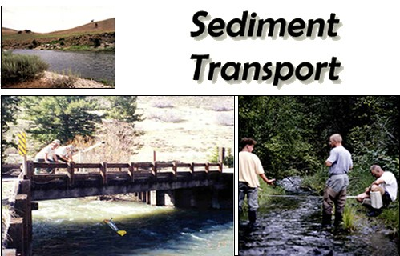
Topic 5: Sediment Transport Modelling using HEC-RAS Model
Introduction to Sediment Transport Concepts in HEC-RAS
Defining the required settings and parameters for different parts of a Sediment Transport process (Transport Function, Sorting method, Fall Velocity, Bed Gradation, Different Sediment Boundary types)
Describing the details of Sediment Properties Options (such as Cohesive options, Bed change options, Calibrate Transport Function, Bed Mixing Options)
Sediment Computation Options and Tolerances
Running the 1D HEC-RAS model and Visualising Sediment related outputs (Bed change, Input-output Sediment volumes, Sediment Spatial Plot, Sediment Time Series)
Notes:
The slides must be written with sobriety, without the use of too many colors (strictly necessary) and with short sentences. Line spacing 1-1.5.
Links to movies, pdfs, web pages and so on can be inserted. All hyperlinks must be openable from the ppt.
If there are hyperlinks in the slide, it is advisable to indicate, in the notes field, when the content of the link will be commented: before, after or simultaneously with the mouse click that opens the hyperlink. It is necessary for the Production (USGM) to acquire in advance all the videos downloaded from the Web (for example from YouTube).

Slide 9
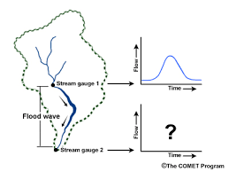
Topic 6: Unsteady Flow Simulation in Natural Rivers and Flood Routing
Introduction to 1D Unsteady Flow modelling
Building a geometry for a river reach
Defining Unsteady Flow Hydrograph datasets
Defining the required settings and parameters for Running Model in a Stable Mode (Time Step, Courant Number, , HEC-RAS Unsteady Computation Options and Tolerances)
Running the Model and Visualising the Routed Flood Hydrograph at Downstream and different Locations
Assessing the Factors that Effect of the Satability and Accuracy of Unsteady Model.
Notes:
The slides must be written with sobriety, without the use of too many colors (strictly necessary) and with short sentences. Line spacing 1-1.5.
Links to movies, pdfs, web pages and so on can be inserted. All hyperlinks must be openable from the ppt.
If there are hyperlinks in the slide, it is advisable to indicate, in the notes field, when the content of the link will be commented: before, after or simultaneously with the mouse click that opens the hyperlink. It is necessary for the Production (USGM) to acquire in advance all the videos downloaded from the Web (for example from YouTube).

Slide 10
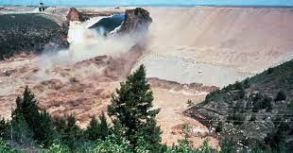
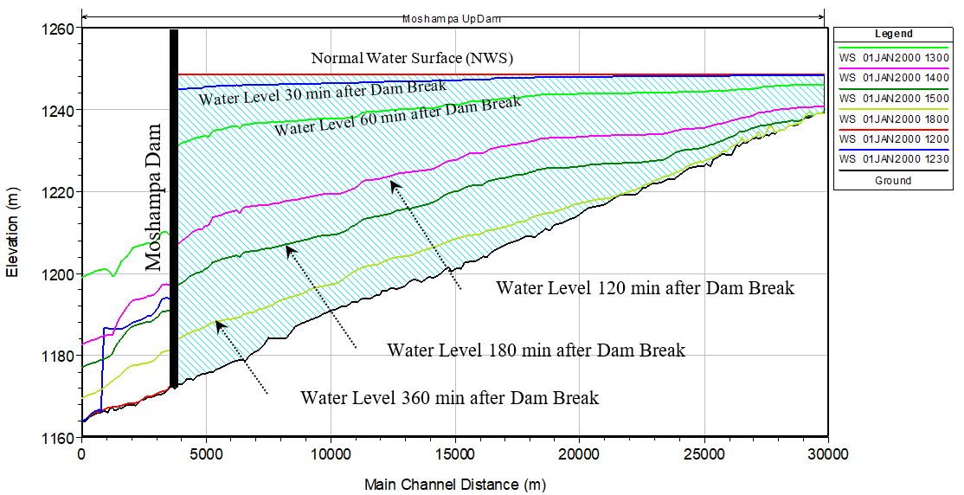
Topic 7: Dam Breach simulation in Real Case Studies
Introduction to Dam Breach Simulation
Estimating Dam Breach Parameters using Different Experimental and Semi-Experimental Formulas
Studying Causes and Types of Dam Failures (Piping, Overtopping)
Defining the required settings and parameters for Running Model in a Stable Mode (Time Step, Courant Number, , HEC-RAS Unsteady Computation Options and Tolerances)
Running the Model and Visualising the Routed Flood Hydrograph at Downstream of Failured Dam
Assessing the Factors that Effect of the Satability and Accuracy of Unsteady Model.
Notes:
The slides must be written with sobriety, without the use of too many colors (strictly necessary) and with short sentences. Line spacing 1-1.5.
Links to movies, pdfs, web pages and so on can be inserted. All hyperlinks must be openable from the ppt.
If there are hyperlinks in the slide, it is advisable to indicate, in the notes field, when the content of the link will be commented: before, after or simultaneously with the mouse click that opens the hyperlink. It is necessary for the Production (USGM) to acquire in advance all the videos downloaded from the Web (for example from YouTube).

Slide 11
Conclusions
By the end of this course, you will understand the 1D river modelling capabilities of HEC-RAS model and when to apply the software to different types of applications.
This course will allow you to familiarise yourself with the various tools and features within the software, allowing you to build your own 1D river model, run simulations, troubleshoot common modeling issues and interpret results.
You will learn all about Sediment Transport Modelling form zero to hero.
After this course, you will be a Master in River Modelling, Flood Inundation Mapping, Bridge Scour estimation, Dam Breach and Unsteady Flow Simulation for each case studies.
Notes:
At the end of each lesson, the teacher should proceed with a summary of the topics covered and take leave using the formula "Thank you for your attention".

Slide 12
Thank you for your attention

