Slide 1
ADMINISTRATIVE AND FINANCIAL
ARRANGEMENTS
Ilaria Reggiani
Università degli Studi Guglielmo Marconi
UNI-TEL Kick-off Meeting
01 - 02 February 2021

Slide 2
OVERVIEW
Key Documents
Financial basic statements and terms
Unit costs (Staff, Travel & Cost of stay)
Actual costs (Equipment & Subcontracting)
Reporting and scheduling of payments
Amendments
Financial reporting by EC
Checks & Audits

Slide 3
KEY DOCUMENTS
UNI-TEL OFFICIAL DOCUMENTS
Grant Agreement (n. 617496-EPP-1-2020-1-IT-EPPKA2-CBHE-JP + Annexes)
Partnership (Internal) Agreement between Coordinator and Partners
ERASMUS Programme Guide – Call for proposals 2020 (EAC/A02/2019)
MONITORING TOOLS
UNI-TEL Project Handbook + Annexes (Deliverable N. 7.1)
Approved project budget
LINKS
Google DRIVE https://drive.google.com/drive/folders/1QG6hebwP5qCZb-2z4UNrpeGWMIEDjKpV?usp=sharing
EACEA beneficiary space: https://eacea.ec.europa.eu/erasmus-plus/beneficiaries-space/capacity-building-in-field-higher-education-2020_en
(where you can find the EU Programme, Reporting Documents, new amendments..)
Notes:
Documents on which this presentation is based and key documents and links for reporting of costs

Slide 4
Financial basic statements and terms
Funding rule & Financing approach
UNI-TEL Budget

Slide 5
Funding rule & Financing approach
Capacity-building projects in the field of higher education incur a large variety of costs, including staff costs, travel costs and costs of stay, equipment costs, sub-contracting costs, costs for dissemination of information, publishing, translation, overheads costs, etc.
The word "grant" refers to the amount of financing that may be requested from the programme, representing the European Union financial contribution to the project, and should not be mistaken with the total costs of a project which also includes co-funding from the partner institutions and external stakeholders.
Notes:
The word "grant" refers to the amount of financing that may be requested from the programme, representing the European Union financial contribution to the project, and should not be mistaken with the total costs of a project which also includes co-funding .
The EU grant to the projects has to be considered as a contribution to cover part of the actual costs incurred by the partner institutions in carrying out the activities foreseen in the application/project. Participation in a Capacity-building project necessarily requires co-funding from the beneficiary institutions.

Slide 6
Funding rule & Financing approach
The financial support to Erasmus+ Capacity-building projects is based on an estimated budget combining contribution to unit costs and actual/real costs.
Co-funding principle
Grant ≠ Total costs of the project
Co-financing implies that the EU grant may not finance the entire costs of the project Applicants do not have to provide information about sources of funding other than the EU grant, nor they have to justify the costs incurred by the project.
Grant (combination of two different financing approaches)
UC: Unit Costs (Staff, Travel and Costs of stay)
AC: Actual costs (Equipment, Subcontracting and Exceptional costs)

Slide 7
UNI-TEL ESTIMATED BUDGET OF THE ACTION
(Annex III of Grant Agreement)
Maximum Contribution to the Project Costs
HEADINGS | TOTAL EURO
STAFF COSTS | 348.284,00
TRAVEL COSTS | 121.885,00
COST OF STAY | 179.040,00
EQUIPMENT | 158.550,00
SUBCONTRACTING | 69.300,00
TOTAL BUDGET | 877.059,00
UNITS COSTS
ACTUAL COSTS
* the costs of face to face meetings (travel and costs of stay), that we will not be able to organise, will be put apart

Slide 8
UNIT COSTS
Definition
Staff costs
Travel costs and costs of stay

Slide 9
UNIT COST - DEFINITION
Fixed contribution multiplied by number of units,
based on "Triggering events" (activities/outputs)
No need to justify level of spending
Need to proof the expenditure/workload/Travel
Financial control/audit declared unit costs supported with proofs of activities implemented
Declared unit costs ------ > proofs of activities implemented

Slide 10
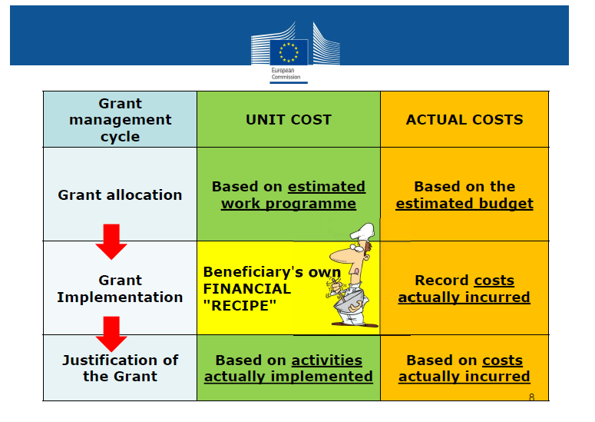
UNIT COST - DEFINITION

Slide 11
UNIT COSTS - STAFF COSTS
Contribution to Institutions for Staff* performing tasks necessary to achieve the objectives of the project
Unit cost = amount in Euro per working day per staff (not linked to the actual level of remuneration in the salary slip)
Calculation 3 variables: staff category, country, number of days
Categories: Managers, Researchers/Teachers/Trainers, Technical, Administrative
*Formal contractual relationship with a beneficiary organisation

Slide 12
UNIT COSTS - STAFF COSTS
 | Manager | Reacher/Trainer/ Researcher/ | Technician | Administrative staff
Italy, Finland | 280 | 214 | 162 | 131
Portugal, Greece | 164 | 137 | 102 | 78
Iran | 77 | 57 | 40 | 32
It is relevant the nature of work performed, not status of individual (not a huge discrepancy from the contractual role and the tasks/roles performed)
Country in which staff is employed, independently of where tasks are executed
Number of days proportioned to the work carried out (not more than 20 DD per month/240 DD per year)

Slide 13
STAFF costs - Supporting documents
To keep with project accounts:
Staff Costs
Joint Declaration (EACEA template)
Time-sheets (EACEA template)
Proof of formal contractual relationship /summary in English
Evidence justifying workload and activities/outputs (e.g. attendance lists , tangible outputs / products)
Payslips and proof of salary payments
To send with periodical reporting

Slide 14
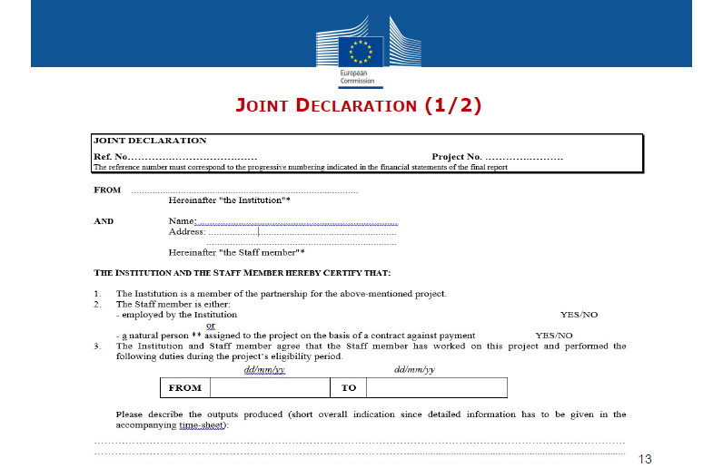
STAFF costs - Supporting documents

Slide 15
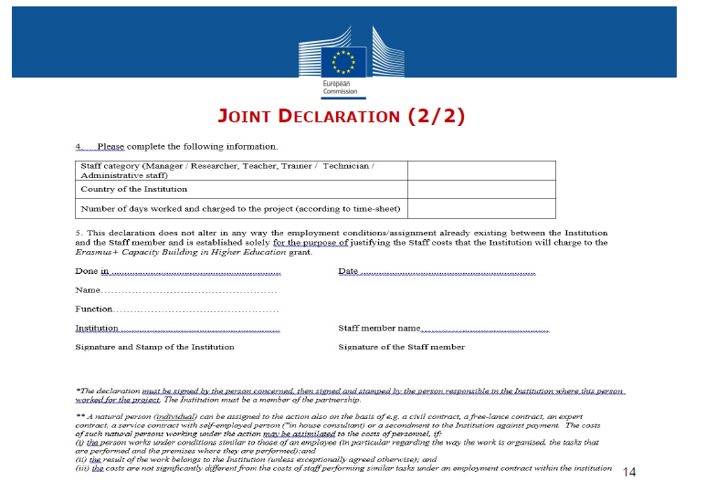
STAFF costs - Supporting documents

Slide 16
STAFF costs - Supporting documents

Slide 17
Travel costs and Costs of Stay
Travel/stay for staff participating in eligible activities related to the achievement of the project
Based on the duration of the stay (including travel) of the participants.
Calculation: 3 variables travel distance (travel costs), duration (costs of stay) and type of participant
UNI-TEL: Staff
Under contract with beneficiary
Travels intended for the activities listed in the E+ Programme Guide

Slide 18
Travel costs: rules
From home institution to venue of activity
(project beneficiaries' countries) and return
Travel distance calculator (one-way travel):
https://ec.europa.eu/programmes/erasmus-plus/resources/distance-calculator
Calculation
unit cost corresponding to applicable
distance band

Slide 19
Travel costs: rules
Financial support will be provided only for travels that are directly related to the achievement of the objectives of the project
Contribution to unit costs:
For travel distances between 10 and 99KM: 20 EUR per participant
For travel distances between 100 and 499 KM: 180 EUR per participant
For travel distances between 500 and 1999 KM: 275 EUR per participant
For travel distances between 2000 and 2999 KM: 360 EUR per participant
For travel distances between 3000 and 3999 KM: 530 EUR per participant
For travel distances between 4000 and 7999 KM: 820 EUR per participant

Slide 20
Costs of stay: specific rules
Staff activities outside city of their home institution.
Costs for subsistence, accommodation, local and public transport such as bus and taxi, personal or optional health insurance.
Calculation:
number of days of activities (including travel) = Number of unit costs
Unit costs for staff
Staff | 120 €
DAYS | Up to 14th day

Slide 21
TRAVEL AND COST OF STAY: Supporting documents
Travel and Costs of Stay
agendas, tangible outputs/products, minutes*
Individual Travel Report (EACEA templates)
hotel invoices and receipts;
travel tickets, boarding passes with points of departure and destination, dates and name of the person travelling / Proofs of payment;
*Non-exhaustive list
To send with Final Financial statement

Slide 22
Actual costs
Definition
VAT
Exchange rate
Tendering procedure
Equipment
Subcontracting

Slide 23
Actual costs - Definition
Expenses actually incurred
(Documented and justified with corresponding level of cost)
Example:
Reported cost (laptops) of 1.500 EUR
=
Supporting documents to the value of 1.500 EUR

Slide 24
Actual costs - Equipment
Relevant to the objectives of the project and
foreseen in the application
the total purchase cost of the equipment will be taken into account and not the equipment's depreciation
Exclusively for Partner Country Higher Education Institutions Recorded in the inventory of the institution
Labelled with E+ stickers (to be printed by beneficiaries)
https://eacea.ec.europa.eu/about-eacea/visual-identity-and-logos-eacea/erasmus-visual-identity-and-logos_en
Equipment not foreseen in the application? (Serious) Delays in the purchase/instalment?
Prior authorization from the Agency
Notes:
Equipment should be instrumental to the objectives of the project and should therefore be purchased at the beginning of the project implementation period. The procurement and delivery of equipment to Partner Country institutions is often a rather complex procedure that should be taken into consideration at the planning stage. In addition, as above mentioned, VAT is not considered as an eligible project cost. Therefore, the measures for the exemption should be launched sufficiently in advance to the purchase of the equipment.

Slide 25
Important recommendations for Equipment
Send the list of revised equipment within 6 months by the beginning of the project (June 2021)
Purchased and installed not later than 12 months before the end of the project
Notes:
Equipment should be instrumental to the objectives of the project and should therefore be purchased at the beginning of the project implementation period. The procurement and delivery of equipment to Partner Country institutions is often a rather complex procedure that should be taken into consideration at the planning stage. In addition, as above mentioned, VAT is not considered as an eligible project cost. Therefore, the measures for the exemption should be launched sufficiently in advance to the purchase of the equipment.

Slide 26
Actual costs - Subcontracting
Implementation of specific tasks, by third party, to which a contract is awarded by one/several beneficiaries
Tasks that cannot be performed by Beneficiaries
NO project-management related tasks
Organization of final conference
Printing posters/leaflets
Translation
Consultancy for external experts
Financial audit
Subcontracting not foreseen in the application?
Prior authorization from the Agency

Slide 27
Actual costs - Supporting documents
Equipment
Invoice(s) and proofs of payment
Subcontracting
Invoice(s), subcontracts and proofs of payment
> EUR 25.000 < EUR 134.000: tendering procedure and three quotations from different suppliers
EUR 134.000: procedure according to national legislation
Registration in the inventory
> EUR 25.000 < EUR 134.000: tendering procedure and three quotations from different suppliers
EUR 134.000: procedure according to national legislation
Travel activities of subcontracted service provider: copies of travel tickets, boarding passes, invoices and receipts
To keep with project accounts
To be sent with Final Financial statement and for periodical reporting:
>EUR 25.000: best value for money, invoices, subcontracts for subcontracting, competitive offers
Notes:
where the value of a contract awarded in accordance with those Articles is over EUR 25.000 and less than EUR 134.000, the beneficiaries shall launch a tendering procedure and obtain competitive offers from at least three suppliers and retain the one offering best value for money, observing the principles of transparency and equal treatment of potential contractors and taking care to avoid conflicts of interests.

Slide 28
Actual costs - Recommendations
Always ask for three quotations from different suppliers either for equipment or for subcontracting
Notes:
where the value of a contract awarded in accordance with those Articles is over EUR 25.000 and less than EUR 134.000, the beneficiaries shall launch a tendering procedure and obtain competitive offers from at least three suppliers and retain the one offering best value for money, observing the principles of transparency and equal treatment of potential contractors and taking care to avoid conflicts of interests.

Slide 29
Actual costs
VAT is Ineligible
Unless official document from Iranian Tax Authority proving that the corresponding costs cannot be recovered

Slide 30
Exchange rate
Requests for payment and financial statements must be in euros.
Beneficiaries with general accounts in a currency other than the euro must convert costs incurred in another currency into euros at the average of the daily exchange rates published in the Official Journal of the European Union, determined over the corresponding reporting period, available at: http://www.ecb.europa.eu/stats/exchange/eurofxref/html/index.en.html
Beneficiaries with general accounts in euros must convert costs incurred in another currency into euros in accordance with their usual accounting practices.

Slide 31
Exchange rate
1) From start of eligibility period until receipt of second pre-financing: monthly rate of reception of SECOND PRE-FINANCING – 21 MONTH
2) From date of receipt of second pre-financing until end of eligibility period:
monthly rate of reception of SECOND PRE-FINANCING
All transactions must be declared in EUR in the Final Report
See the excel sheet of the financial statement

Slide 32
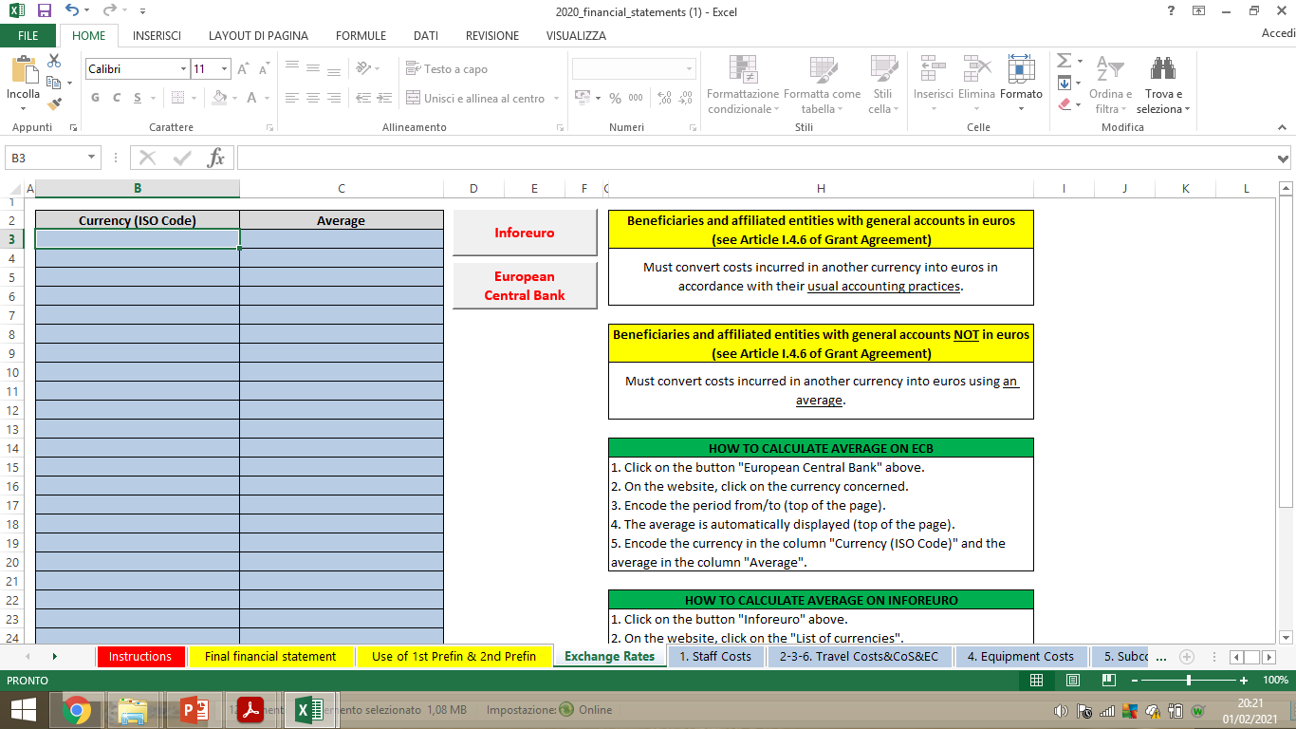
Exchange rate

Slide 33
Eligible Costs
Grant Agreement ARTICLE II.19 — ELIGIBLE COSTS
Incurred by the beneficiaries during the eligibility period
(UNI-TEL: 15/01/2021 – 14/01/2024)
Foreseen in the application/budget
In connection with action/necessary for project implementation
Identifiable, verifiable, recorded in the accounting records
Comply with requirements of tax/national legislation
Reasonable, complying with sound financial management
(Economy and Efficiency)

Slide 34
Ineligible Costs
Costs NOT fulfilling requirements of Art. II.19.1
Grant Agreement II.19.4 Ineligible costs
examples:
equipment such as: furniture, motor vehicles, alarm systems
costs linked to the purchase of real estate
activities not in project beneficiaries' countries unless prior authorization
Exchange losses
in kind contribution
excessive expenditure
deductible VAT

Slide 35
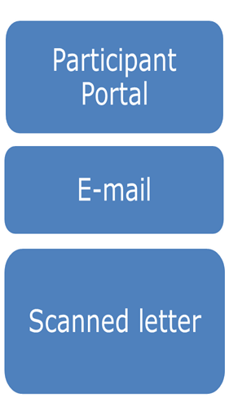
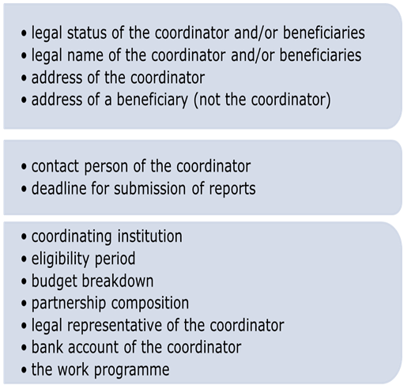
Amendments
Request change of Done through…….

Slide 36
Amendments: Budget Transfers (between budget headings)
Increase
UP to 10%
No prior authorization
Increase by MORE than 10%
Amendment
Ceilings cannot be exceeded

Slide 37
Payments: Possible scenarios
Austrian Organisation Exchange Payments’ Service
To be confirmed by EU Project Officer
Iranian Embassy in Italy as Intermediary
To be confirmed by Embassy - Head of Financial Office
Cash Payments
Difficulties within pandemic restrictions
PAYMENTS TO INDIVIDUAL BANK ACCOUNTS ARE NOT ALLOWED

Slide 38
Reporting and scheduling of payments 1/2
Payments are linked to BOTH EACEA and internal reporting
20% of the estimated Erasmus+ grant contribution at the project beginning (I tranche) – As soon as we receive the EU authorization for the payments’ procedure
30% of the estimated Erasmus+ grant contribution after the submission and acceptance of first internal monitoring covering the first 10 months of the project (technical and financial reporting (II tranche - November 2021)
Partners will submit all the necessary proofs of expenditure/activity based on the documents and reporting templates provided by the Executive Agency and the Coordinator and accessible though Google Drive + Management Handbook

Slide 39
Reporting and scheduling of payments 2/2
Payments are linked to BOTH EACEA and internal reporting
20% of the estimated Erasmus+ grant contribution after the approval of the progress report by the Executive Agency (M 21 - III tranche 20% of prefunding)
20% of the estimated Erasmus+ grant contribution after the submission and acceptance of second internal monitoring (M 28 – IV tranche 20% of prefunding)
Final balance, after the approval of the Final Report (M36) by the Executive Agency*.
(*Final balance will be reduced of expenses anticipated by the Coordinator)

Slide 40
3rd internal reporting
IV tranche 20% of prefunding
1st internal reporting:
II tranche 30% of prefunding
September 2022
M21
January
2024
M36
November 2021
M10
April 2023
M28
Interim report for the EACEA and 2nd internal reporting
III tranche 20% of prefunding
After the approval of the Final report to EACEA
V tranche 10% of funding
Approximately April 2024
Notes:
TEMPLATES TO BE PROVIDED BY MID MARCH ON DRIVE. Each partner must fill in the document but the WP leader will have the task to provide an overview of their wP

Slide 41
Financial Monitoring and Reporting by EC
Financial monitoring per budget heading/partner/WP during project implementation (for budget consumption)
Statement on the use of the previous pre-financing for PR and request for second pre-financing
Financial reporting at final report stage, supported by Audit Certificate (Report of Factual Findings on the Final Financial Report )
Financial Statements (".xls" format) available in the UNI-TEL drive folder or in
https://eacea.ec.europa.eu/erasmus-plus/beneficiaries-space/capacity-building-in-field-higher-education-2020_en
Financial statements (Excel) main financial reporting tool:

Slide 42
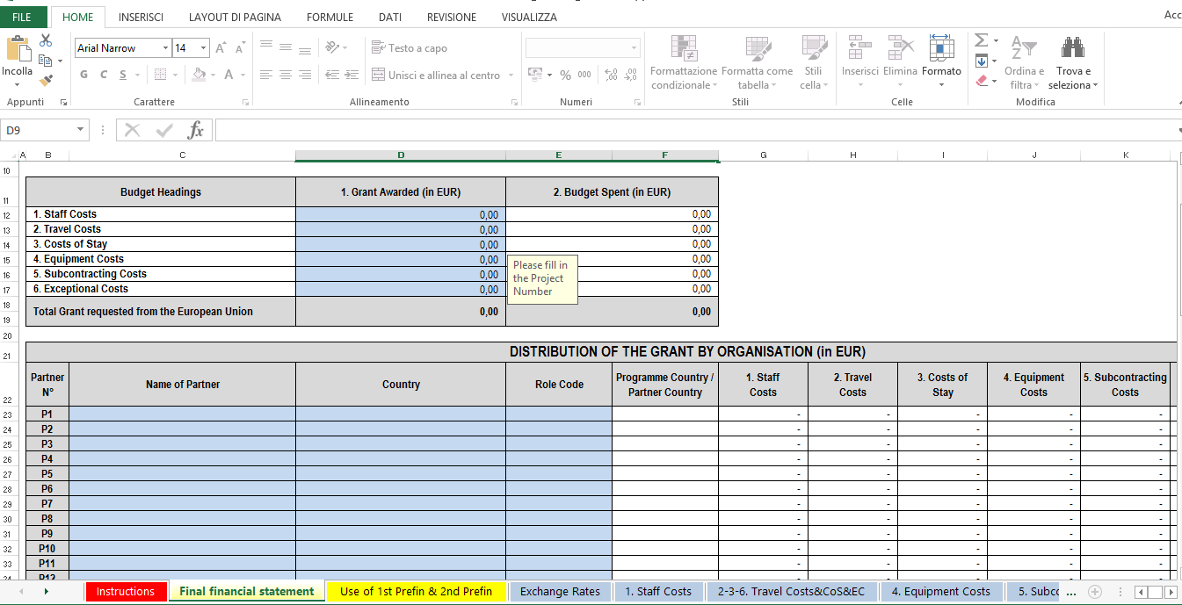

Slide 43
Check & Audits
EACEA/Commission may carry out technical/financial checks and audits in relation to the use of the grant
During implementation of Agreement and for a period of 5 years starting from the date of payment of the balance/recovery order
Usually outsourced to external auditors
At premises of coordinator and/or partners

Slide 44
Thank you for listening!
Ilaria Reggiani
i.reggiani@unimarconi.it
Ph: 0039 06 37725526

