Slide 1
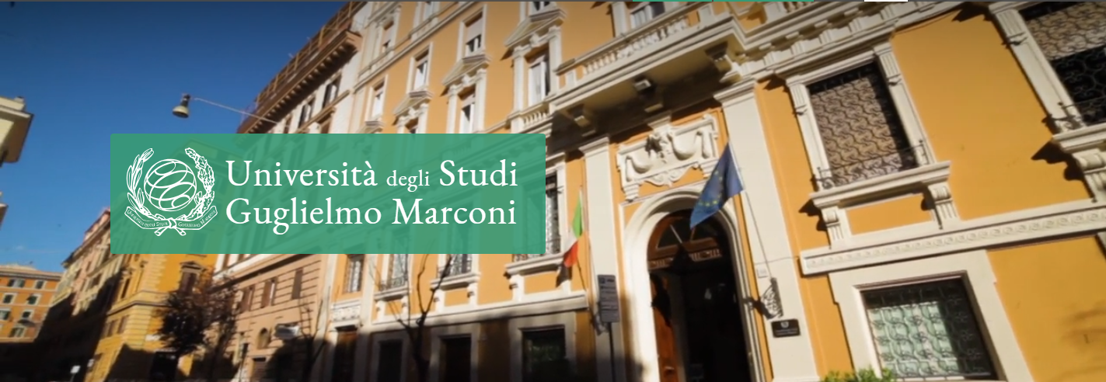
INTERNATIONALIZATION
Department of Research & Development
Guglielmo Marconi University
WELCOME TO:
GUGLIELMO MARCONI
UNIVERSITY
Distance Education
e-Learning
Emergency Remote Teaching
Theoretical and historical background
Francesco C. Ugolini
Associate Professor
Experimental Education
Università degli Studi Guglielmo Marconi

Slide 2
INTERNATIONALIZATION
Department of Research & Development
Guglielmo Marconi University
Distance Education … so many phrases!
Historical context
Anni 1930-40: sviluppo broadcasting radio-televisivo
1960: increaing needs of Education
XIX century: development of transports and mail service
1980: Development of CMC
1990: «Learning Society» in Europe
1990: launch and spreadi of WWW
2020: COVID-19 pandemic
Distance Education
2020: Emergency Remote Teaching
1840: Courses by mail, first generation of Distance Education
1989: Online Learning
1969: Open Education
1999-2001: e-Learning
1991: Open Distance Learning

Slide 3
INTERNATIONALIZATION
Department of Research & Development
Guglielmo Marconi University
Online Learning vs Emergency Remote Teaching
In 2020, due to the COVID-19 pandemic, almost every country needed to suddenly switch to online education, even if teachers and educational managers didn’t plan to.
The Distance Education devices in 2020 were not appropriately designed to take advantage of this learning mode. That’s why we’d better use the phrase Emergency Remote Teaching.

Slide 4
INTERNATIONALIZATION
Department of Research & Development
Guglielmo Marconi University
Online Learning vs Emergency Remote Teaching
«These hurried moves online by so many institutions at once could seal the perception of online learning as a weak option, when in truth nobody making the transition to online teaching under these circumstances will truly be designing to take full advantage of the affordances and possibilities of the online format».
«The design process and the careful consideration of different design decisions have an impact on the quality of the instruction. And it is this careful design process that will be absent in most cases in these emergency shifts»
(Hodges et al., 2020)

Slide 5
INTERNATIONALIZATION
Department of Research & Development
Guglielmo Marconi University
Which phrase is the best?
Since 1999, the most common phrase regarding Distance Learning actually is e-learning.
This wording did replace many other significant terms, making happen a huge terminological simplification.
Generally speaking, Distance Education is a field in which misunderstandings are easily generated.

Slide 6
INTERNATIONALIZATION
Department of Research & Development
Guglielmo Marconi University
What is e-learning?
That’s why we should consider to make a careful analysis of each phrase, as it can help to better understand what actually is e-learning.
What’s e-learning again?

Slide 7
INTERNATIONALIZATION
Department of Research & Development
Guglielmo Marconi University
There’s a problem from the very start
«‘e-learning’ is a great phrase, as it is a wider tent than just on-line learning, web-based training, CBT, technology assisted distance learning or other phrases»
Elliott Masie, 1999

Slide 8
INTERNATIONALIZATION
Department of Research & Development
Guglielmo Marconi University
Inside the «wider tent»…
E-learning
Distance Education
Computer Based
Training
Open Distance
Learning
KM
On-line
Learning
Web Based Training

Slide 9
INTERNATIONALIZATION
Department of Research & Development
Guglielmo Marconi University
From Open Distance Learning to e-Learning
Open Distance Learning was the most important concept-laden phrase been swept out by the «e-» things…
A huge switch took place in the early 2000’s from an education-laden phrase (Open Distance Learning) to a technology/economy one (e-Learning)

Slide 10
INTERNATIONALIZATION
Department of Research & Development
Guglielmo Marconi University
What was Open Distance Learning?
«An Open Distance Learning device
- is an organised device, on purpose, aknowledged as such by the actors,
- which takes care of people singularity in their individual and collective dimension,
- and which is built on learning situations that are complementary and plural in terms of time, place, human and technological pedagogical mediations and resources»
Collectif de Chasseneuil, 2000

Slide 11
INTERNATIONALIZATION
Department of Research & Development
Guglielmo Marconi University
What switching to e-Learning implies?
«Business is adding the letter "e" in front of a lot of words in the last year of the 1900's. e-commerce, e-business, e-shopping, e-transactions, and now e-learning. The "e" has come to stand for a Digital Age and internet focused transformation of a business process. "e" literally means the "electronic" personification of a commerce, shopping or learning. But, it also means modern, internet age, "venture capital friendly" and on-line.»
Masie, 1999
«e-Learning is a strategy that encompasses and utililises today’s technologies to satisfy business drivers»
Quilter, 2000

Slide 12
INTERNATIONALIZATION
Department of Research & Development
Guglielmo Marconi University
A major change in EU policies
1991 - Memorandum on Open Distance Learning
2001 – eLearning Action Plan
eLearning is definded as «The use of new multimedia technologies and the Internet to improve the quality of learning by facilitating access to resources and services as well as remote exchanges and collaboration.»
EC, 2001

Slide 13
INTERNATIONALIZATION
Department of Research & Development
Guglielmo Marconi University
ODL and E-L: a synthesis
Open Distance Learning | E-Learning
Educational device Any time, any place, any pace Taking into account learner’s singularity ⇨ Learner centration Flexibility | Business device A «wider tent» Improving quality of learning ⇨ Customer satisfaction Sustainability

Slide 14
INTERNATIONALIZATION
Department of Research & Development
Guglielmo Marconi University
Two other phrases: 1) On-line learning
On-line learning (aka the third generation of Distance Education)
It has been introduced in the late 80s (before World Wide Web was created by Sir Tim Berners-Lee in the early 90s)
People may interact via computer (Computer-Mediated Communication – CMC)

Slide 15
INTERNATIONALIZATION
Department of Research & Development
Guglielmo Marconi University
Two other phrases: 1) On-line learning
1st generation of Distance Education
XIX Century, interaction via «snail» mail
Communication 1 to 1 between teacher and learner
2nd generation of Distance Education
60s, interaction also via TV
Communication 1 to many between teacher and learners
3rd generation of Distance Education
On-line learning
From late 80s on, interaction via Computer
Communication many to many
between teachers/tutors and learners
between learners

Slide 16
INTERNATIONALIZATION
Department of Research & Development
Guglielmo Marconi University
Two other phrases: 2) Computer/Web based training
Computer-Based Training (CBT) and then Web-Based Training (WBT) are linked to another branch, dealing with the use of computer and IT resources to improve learning
Mainly based on interaction Human-Machine rather than Human-Human Ex: delivery of formative assessment tests, or hypermedia content delivery
Started from stand-alone computers, then went on thanks to CD-ROM supports, and finally evolved to a web-based delivery (content can be frequently updated)

Slide 17
INTERNATIONALIZATION
Department of Research & Development
Guglielmo Marconi University
We have both inside the e-learning «wider tent»…
E-learning
Distance Education
Computer Based
Training
Open Distance
Learning
KM
On-line
Learning
Web Based Training

Slide 18
INTERNATIONALIZATION
Department of Research & Development
Guglielmo Marconi University
An e-learning device therefore allows…
Content delivery that may grant interaction human-machine and can be easily updated
Interaction between teacher/tutors and learners and between learners

Slide 19
INTERNATIONALIZATION
Department of Research & Development
Guglielmo Marconi University
An e-learning device can implement all three main learning paradigms
Rationalist-Informationist
Content-based, standing upon a transmission from teacher to students, then feebacks from students to teachers and then again support from teacher to students.
Systemic-Interactional
Mainly interaction based, making use of learning by discovery; students are active and are required to face and solve problems (case studies, serious games…)
Constructivism Socio-Educational
Building of virtual communities
(Galliani, 2002)

Slide 20
INTERNATIONALIZATION
Department of Research & Development
Guglielmo Marconi University
Which one is the best? You don’t really have to choose…
E-learning creates a Learning Environment integrating all three
You can «blend»
The issue is: how to properly design the Learning Environment in order to purchase the Leanring Outcomes?
(Galliani, 2002)

Slide 21
INTERNATIONALIZATION
Department of Research & Development
Guglielmo Marconi University
What’s «Blended learning»? The traditional meaning
The most common meaning of the phrase «blended learning» is an educational device including both distance education and face to face education.
There are some problems wih such definition
Are homework using Internet «blended learning»?
In face-to-face education, technology is often used, namely with smartphones (BYOD) or interactive whiteboard
Traditionally this is called technology enhanced learning
There are much difference between one online solution and another one, rather than between distance and face-to-face

Slide 22
INTERNATIONALIZATION
Department of Research & Development
Guglielmo Marconi University
What’s «Blended learning»? Situation blending
What’s «Blended learning»? Situation blending
According to Pier Cesare Rivoltella (2003, 2005), you can «blend» five «pedagogical classrooms» (situation blending)
Face-to-face
Audio/Video
Content delivery
Multimedia Content Delivery
Virtual Group Activities
Virtual Community
Content based
Interaction based

Slide 23
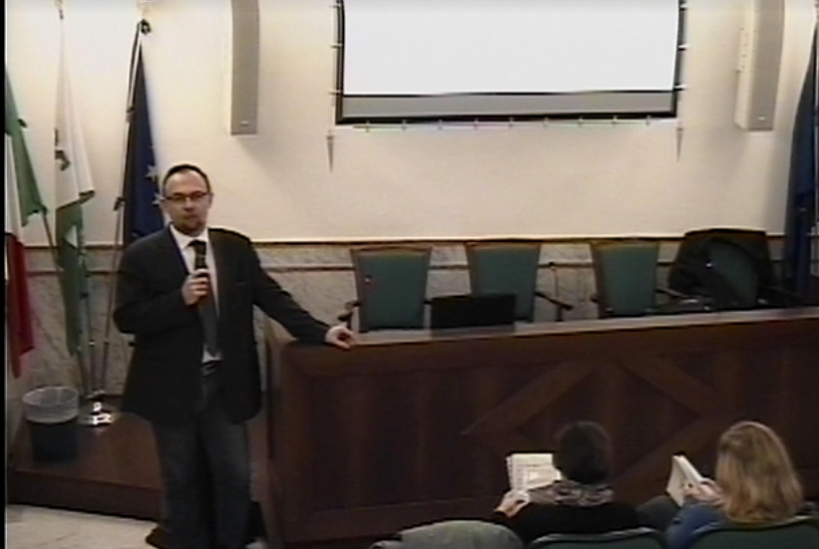
INTERNATIONALIZATION
Department of Research & Development
Guglielmo Marconi University
What’s «Blended learning»? Situation blending
First classroom: the physical classroom.

Slide 24
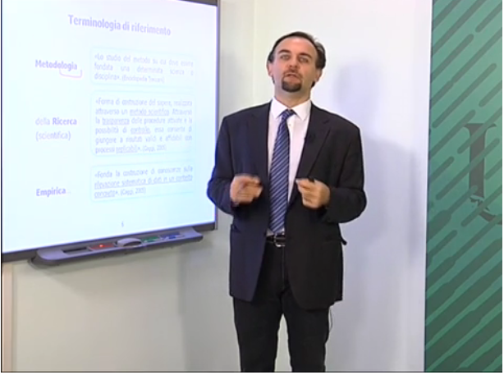
INTERNATIONALIZATION
Department of Research & Development
Guglielmo Marconi University
What’s «Blended learning»? Situation blending
Second Classroom: audio-video content delivery
During the COVID-19 pandemic, many are making use of synchronous video content delivey, moving back to a strongly erogative teaching model.

Slide 25
INTERNATIONALIZATION
Department of Research & Development
Guglielmo Marconi University
What’s «Blended learning»? Situation blending
Third classroom: multimedia content-delivery.

Slide 26
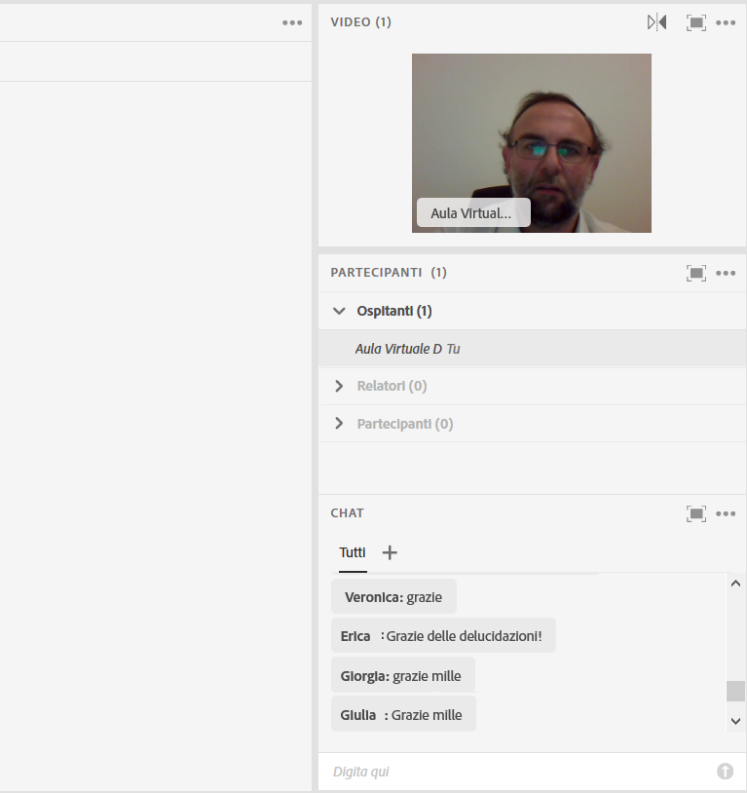
INTERNATIONALIZATION
Department of Research & Development
Guglielmo Marconi University
What’s «Blended learning»? Situation blending
Fourth classroom: Virtual group activities.

Slide 27
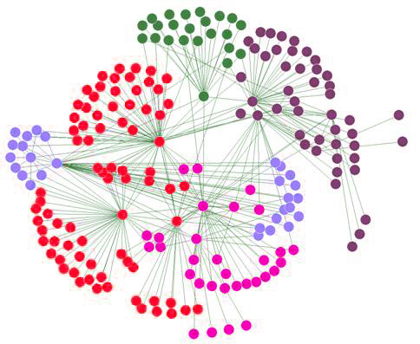
INTERNATIONALIZATION
Department of Research & Development
Guglielmo Marconi University
What’s «Blended learning»? Situation blending
Fifth virtual classroom: the community.

Slide 28
INTERNATIONALIZATION
Department of Research & Development
Guglielmo Marconi University
What’s «Blended learning»? Timing blending
According to Singh (2003), you can blend self-paced and live, collaborative learning. He namely found out three main approaches related to timing
Synchronous physical formats
Synchronous online formats (Webinar, Virtual Classrooms…)
Self-paced, asynchronous formats (WBT, asynchronous communication tools)

Slide 29
INTERNATIONALIZATION
Department of Research & Development
Guglielmo Marconi University
What’s «Blended learning»? Support blending
According to Bellier (2001), you can blend relating to the support of tutors
Fully distance learning, without the support of a tutor
Fully distance learning, with the support of a tutor
Both face-to-face/distance learning, with self-paced distance learning
Both face-to-face/distance learning, with complementary on-line activities
Collaborative working on-line

Slide 30
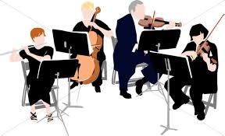
INTERNATIONALIZATION
Department of Research & Development
Guglielmo Marconi University
An orchestra teaching
Teaching face-to-face is brought up by a single teacher (solo)
The same person creates, organises, designes, prepares and delivers his/her course
Teaching on-line involves many professionals (orchestra)

Slide 31
INTERNATIONALIZATION
Department of Research & Development
Guglielmo Marconi University
Several roles in e-learning delivery
The role of the professionals involved in e-learning delivery may vary from one model to another. We can nonetheless identify some reference profiles
Author – content expert
Instructional Designer – content/course design expert
Technical Staff in content production
Disciplinary Tutor – grants student support about course content issues by interaction
Non-disciplinary Tutor – grants student support about technical/organisational issues

Slide 32
INTERNATIONALIZATION
Department of Research & Development
Guglielmo Marconi University
Building an e-learning course
Course design
Instructional
Designer
Teacher
Author
-
Content
Supervisor
Course Production
Technical
Staff
Course Delivery
Disciplinary
Tutor
Non-disciplinary
Tutor

Slide 33
INTERNATIONALIZATION
Department of Research & Development
Guglielmo Marconi University
Conclusions
From a pedagogical viewpoint, what we call e-Learning actually is Open Distance Learning which makes use of ICT to create a flexible learning environment.
Within this environment, a teaching team can «blend» several pedagogical tool, namely
Content delivery that can foster interaction between student and machine (hypertext, test, serious games, simulations…)
Learning activities supported by synchronous or asynchronous interaction between teacher/tutor and students, or between students

Slide 34
INTERNATIONALIZATION
Department of Research & Development
Guglielmo Marconi University
Thank you for your attention
Francesco C. Ugolini
f.ugolini@unimarconi.it
34

